Slide 1
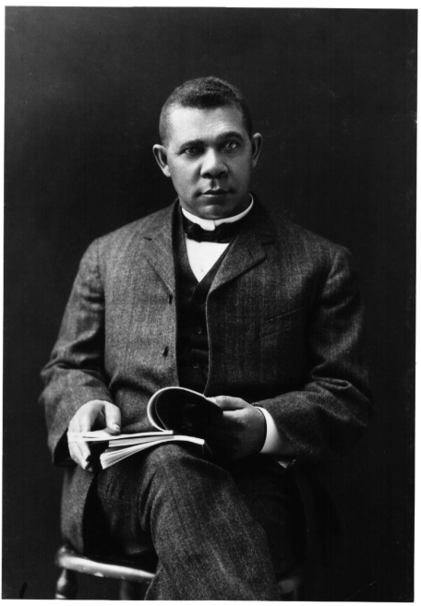
Unit 5: Life in Post-Slavery America
(1875 – 1928)
During the late 1800s and early 1900s African-Americans struggled to find their place in the United States, while also seeking ways to express their voice and culture.
Booker T. Washington (1856 – 1915) serves as an example of blacks trying to earn their success and prove their worth in America during this time period.

Slide 2

Quick Review of Ch. 14 - 15
What kind of difficulties and injustices did blacks face in the South during the late 19th and early 20th century?
How did African-Americans attempt to overcome these hardships?

Slide 3
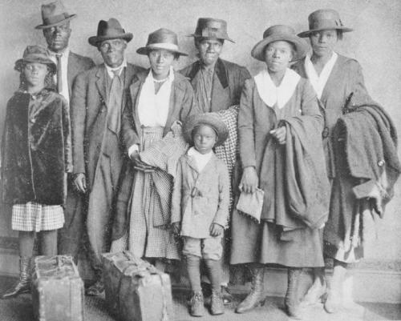
Ch. 16: African Americans in the Early 20th Century (1895 – 1928)
Africans Americans continue to seek ways to better their lives, including the migration of many rural black southerners to the cities of the North in search of economic opportunity.

Slide 4
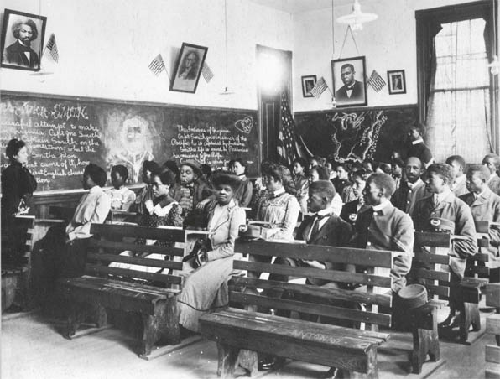
Section 1: Race and Social Change
In the late 19th century, white progressives were fighting to bring social and economic reforms that they believed would better the nation.
At the same time, black leaders were seeking ways for African Americans to overcome the challenges they faced in American society.
Progressive
- Ready to try new methods in the name of progress for society

Slide 5
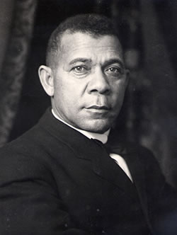
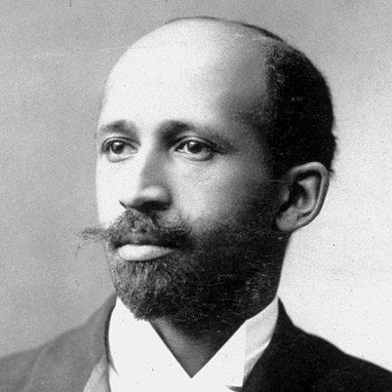
Section 1: Race and Social Change
Blacks leaders had different opinions on the best way for blacks to succeed.
Booker T. Washington, an educator and author, urged blacks to focus on industrial and agricultural education. He argued that if blacks could gain economic acceptance, then they would be in position to gain political and social acceptance.
W.E.B. Du Bois, a historian and author, believed that blacks should not wait for civil rights. They should stand up and demand political and legal equality.

Slide 6
Quick Discussion
Who do you think had the best plan, Booker T. or Du Bois? Why?
Booker T. Washington, an educator and author, urged blacks to focus on industrial and agricultural education. He argued that if blacks could gain economic acceptance, then they would be in position to gain political and social acceptance.
W.E.B. Du Bois, a historian and author, believed that blacks should not wait for civil rights. They should stand up and demand political and legal equality.

Slide 7
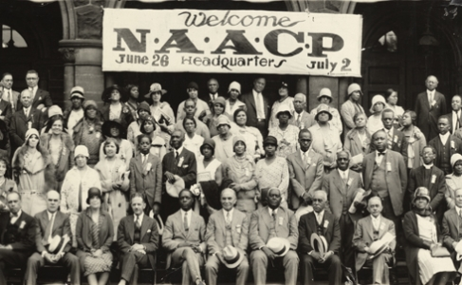
Section 2 New Black Organizations
In 1909, whites and blacks committed to protecting rights for African-Americans founded the National Association for the Advancement of Colored People (NAACP).
The NAACP fought through the judicial and legislative system on behalf of their belief that blacks should fully enjoy the civil and political rights guaranteed to all citizens in the Constitution.
Booker T. Washington was actually against the NAACP, but the organization continued to grow anyway.

Slide 8

Quick Discussion
The NAACP still exists and is active today. Any ideas what it does nowadays?

Slide 9
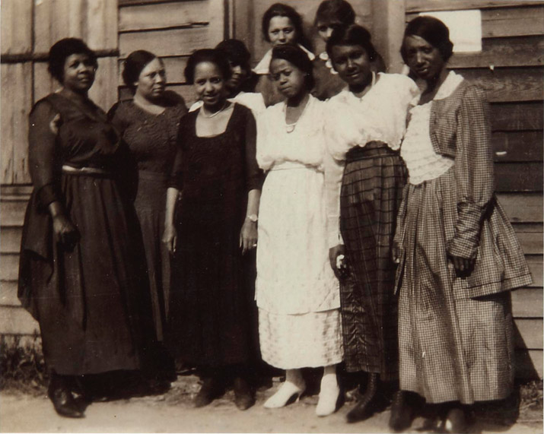
Section 2: New Black Organizations
During this time black women formed clubs that focused on community issues.
  Fighting Poverty
  Ending Racial Discrimination
  Promoting Education
  Caring for Older People
  Helping Orphans
Black women were also active in the women’s suffrage movement (seeking the right to vote for women).

Slide 10
Section 3: Politics and Military
When Woodrow Wilson, a progressive, was elected President in 1912, some black leaders hoped this would help improve the lives of African Americans.
  Unfortunately, once Wilson was in office, he supported segregationist policies.
Why?
Progressive Movement
- Reform movement dedicated to the creation of a new social awareness in America.

Slide 11
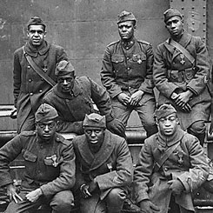
Section 3: Politics and Military
When the US entered World War 1 in 1917, most blacks supported the war effort.
  Many demonstrated their loyalty and devotion to the US by volunteering for military service.
Sadly, blacks continued to endure discrimination and mistreatment in the armed forces. Also, their service in the military did not help to improve the white perception of blacks as many had hoped it would, including Du Bois.

Slide 12
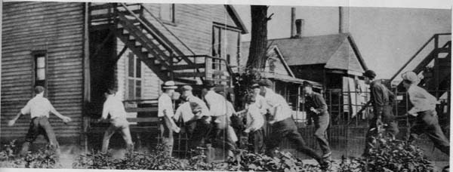
Section 4: Racial Violence
Many black leaders hoped that the 20th century would start a new era in American race relations. They were soon disappointed.
Instead, racial violence continued in the South and even spread to the North as more African Americans migrated to northern cities.
Chicago Race Riot of 1919
- A week long riot in response to increasing tension between whites and the growing black population. Left 23 blacks and 15 whites dead.

Slide 13
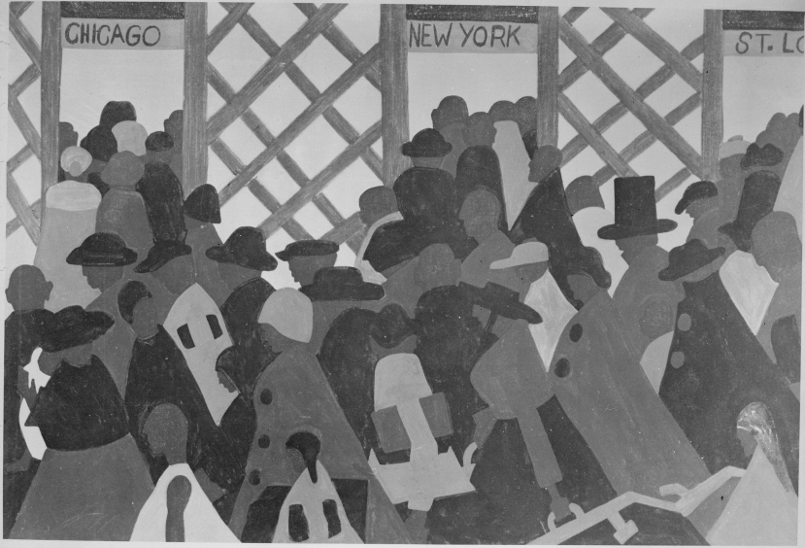
Section 5: The Great Migration
Between 1910 and 1940, almost 2 million blacks moved from the rural South to the urban North.
  They were pushed by poor conditions in the South and the hope of a better life in the North.
Positive
- This led to the development of vibrant black communities in New York City and Chicago.
Negative
- Relocation placed heavy strains on black families as they were often partially separated.

Slide 14
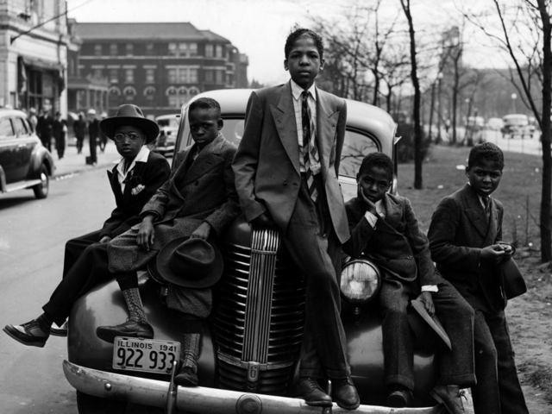
Quick Discussion
Had you been an African-American living in the South during the early 1900s, do you think you would have migrated to the North or remained in the South? Why?

Slide 15
Quick Review
In what ways did African-Americans seek to improve their lives and the lives of all blacks during the early 1900s?

