Slide 1

Review Game
What’s on the ppt?
Chapters 13 - 15

Slide 2
‘What’s on the ppt?’ Rules
2 Teams are Competing
1 Teammate will have his / her back turned to the ppt
Teammates will have 30 seconds to try to describe what is on the ppt, but YOU CAN’T SAY ANY OF THE WORDS ON THE PPT
If the Teammate can guess what’s on the ppt, your team get’s a point!
Whoever ends with the most points wins!

Slide 3
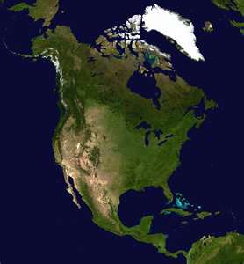
Example
The word is ‘North America’
Teammates can not say ‘North’ or ‘America’
Also, no rhyming or starts with ‘N’

Slide 4
Economy

Slide 5
Wants and Needs

Slide 6

Resources

Slide 7

Market Price

Slide 8
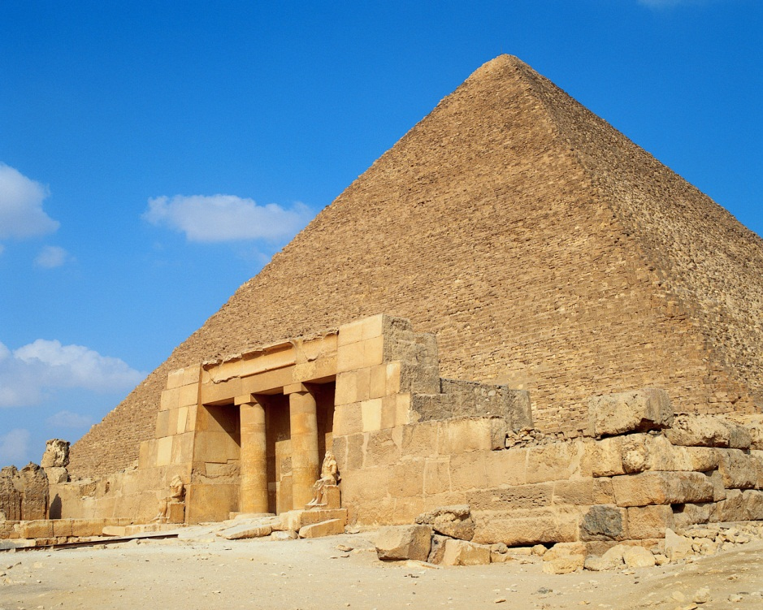
Command Economy

Slide 9

Corporation

Slide 10


Supply and Demand

Slide 11
Market Economy

Slide 12
Sole Proprietorship

Slide 13
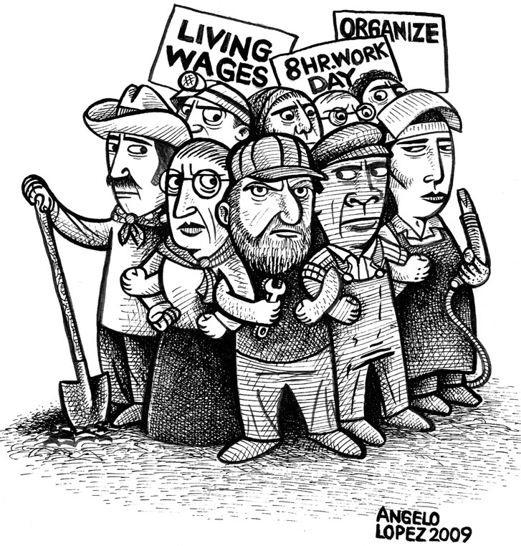
Labor Union

Slide 14

Budget

Slide 15

Investment

Slide 16


Disposable Income

Slide 17


Variable Expenses

Slide 18

Career Plan

Slide 19

Partnership

Slide 20
Interest

Slide 21

Traditional Economy

