Slide 1
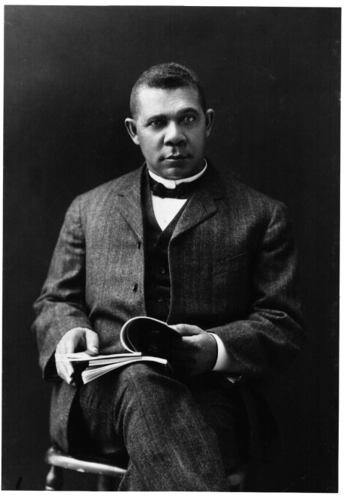
Unit 5: Life in Post-Slavery America
(1875 – 1928)
During the late 1800s and early 1900s African-Americans struggled to find their place in the United States, while also seeking ways to express their voice and culture.
Booker T. Washington (1856 – 1915) serves as an example of blacks trying to earn their success and prove their worth in America during this time period.

Slide 2

Quick Review of Ch. 14
African-Americas in the South in the Late 19th Century
What kind of difficulties and injustices did blacks face in the South during the late 19th century?
How was it possible that these injustices took place?

Slide 3
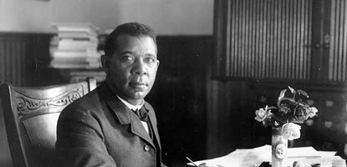
Ch. 15: Black Southerners Challenge White Supremacy (1867 – 1917)
Despite the thinking of many that blacks were naturally inferior to whites, African-Americans strove to establish themselves and better their lives in American society.
Booker T. Washington was the most influential black leader in America by the year 1900.

Slide 4
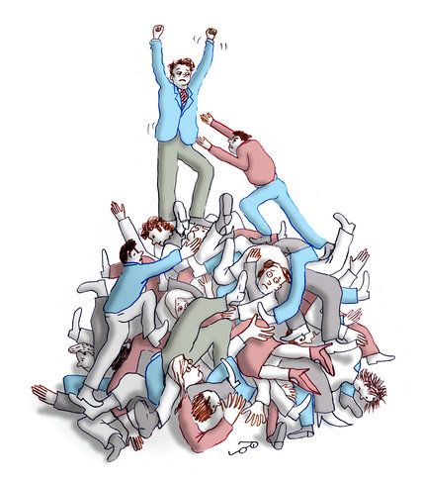
Section 1: Educating African Americans
Social Darwinists argued that the inferior status of blacks in America was a sign of their ‘unfitness’.
  In other words, they were saying that blacks were naturally inferior to whites.
Social Darwinism
- Theory that through natural selection strong people would prosper while weak people would fail.

Slide 5
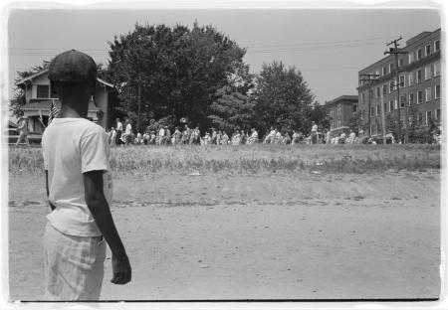
Section 1: Educating African Americans
The truth is that the institution of slavery greatly hindered the lives of African-Americans and even with it abolished, there were still few educational opportunities for blacks, as schools were segregated or in some cases didn’t exist for blacks.
  Black communities responded to this problem by creating private educational institutions, although only those from more prosperous families could attend.

Slide 6

Quick Discussion
Some blacks and many whites believed that the education of black children should focus on practical work skills (like farming and shop-keeping) instead of liberal arts (history, philosophy, etc). Others argued this approach would train blacks to remain subordinate.
What do you think? How could you have argued these two different positions?
Practical Work Skills vs. Liberal Arts

Slide 7
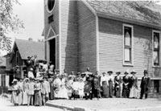
Section 2: Church and Religion
Aside from the family, the church was still the most important institution that played an important part in the daily lives of blacks.
  Key Thought: The church was so influential because it was controlled by blacks themselves. It also provided an opportunity to escape the difficulties of daily lives and focus on the hope of the Christian faith.
Is the church still influential in black communities today? How?
Church Denominations
- While most blacks were Baptists or Methodists, some belonged to Pentecostal, Catholic, or Episcopalian churches.

Slide 8
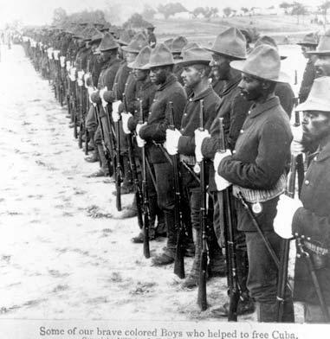
Section 3: Black Troops
Despite harsh conditions, African Americans served in the armed forces during this time, taking pride in their abilities as professional soldiers.
Examples of Harsh Conditions
- Racist Views of Black Soldiers
Inferior Food
Inadequate Housing
Given Used Weapons and Equipment

Slide 9
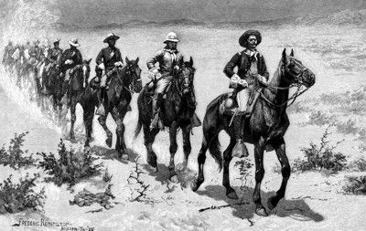
Section 3: Black Troops
Many black soldiers were stationed in the West of the US.
  Some even remaining out West to become cowboys.
Thousands of African-American troops served overseas in the Spanish-American War in 1898 and the Philippine Insurrection that followed it.
  In fact, the War Department believed black soldiers would tolerate the heat and humidity better in locations such as Cuba and the Philippines, where much of the fighting took place.

Slide 10

Section 4: Business and the Professions
Since blacks faced limited opportunities to succeed in ‘white’ businesses, many black business people looked to build businesses that catered to black customers.
Businesses for Black Communities
Banks
Newspapers
Insurance Companies
Retail Stores
Barbershops and Beauty Salons
Funeral Parlors

Slide 11
Quick Discussion
Can you think of any modern examples of black businesses catering to black customers?
Is there anything wrong with that?
How might that be different today than it was in the early 1900s?

Slide 12

Difficulties for Blacks in the Workforce
Despite some success stories, many black-owned businesses struggled to stay open.
Most labor unions excluded black workers.
Black doctors and lawyers still faced discrimination and segregation.

Slide 13
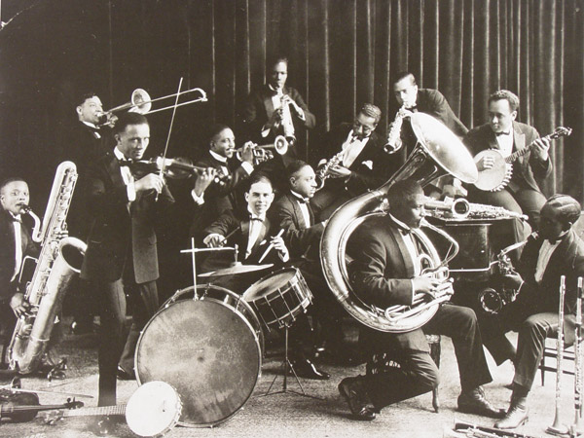
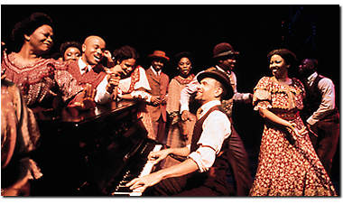
Section 5: Music and Sports
African-Americans helped develop new forms of music in America.
  Ragtime: composed music written for the piano that emerged in the 1890s
  Jazz: music that was mostly improvised and developed in the early 1900s
  Blues: music developed by poor black southerners during the early 1900s

Slide 14

Quick Discussion
How do you think musical styles like jazz and the blues helped African-Americans to express themselves and their culture?

Slide 15
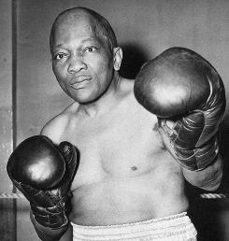
Section 5: Music and Sports
Despite the athletic talents of many African-Americans, black athletes faced increasing opposition to blacks competing alongside and against white athletes.
Heavyweight boxer Jack Johnson was a great fighter. His ability to defeat white boxers angered many, however, it was his involvement with white women that infuriated them even more and led to his eventual imprisonment.

Slide 16
Quick Review of Ch. 15
Black Southerners Challenge White Supremacy
In what ways did black southerners attempt to overcome the battle against white supremacy?

