Slide 1
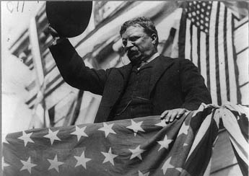
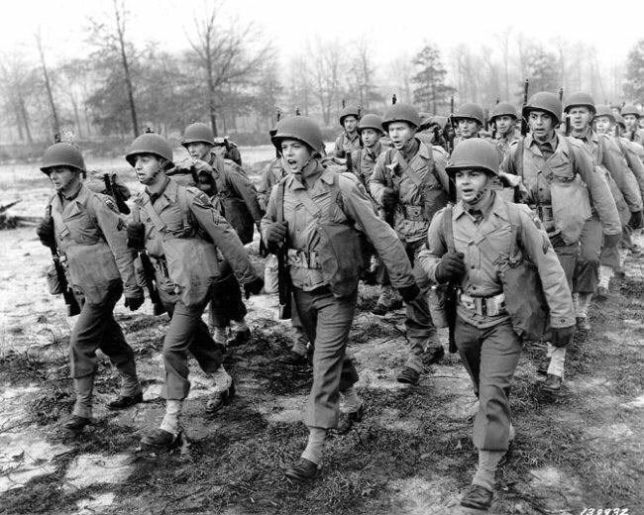
Unit 5: Emergence of the Modern United States (1890 – 1920)
The United States makes progressive changes in it’s government at home while beginning to become a global power abroad through imperialism and involvement in World War 1.

Slide 2

Quick Review of Ch 13
The Progressive Era
What was the goal of Progressives and how did they go about trying to achieve it?
What impact have Progressives left on US government?

Slide 3
Chapter 14: An Emerging World Power
(1890 – 1917)
The US uses political, economic and military tactics to expand it’s influence and territory in the world during this period.

Slide 4

What is Imperialism?
Can you explain without looking at the answer on the next slide?

Slide 5
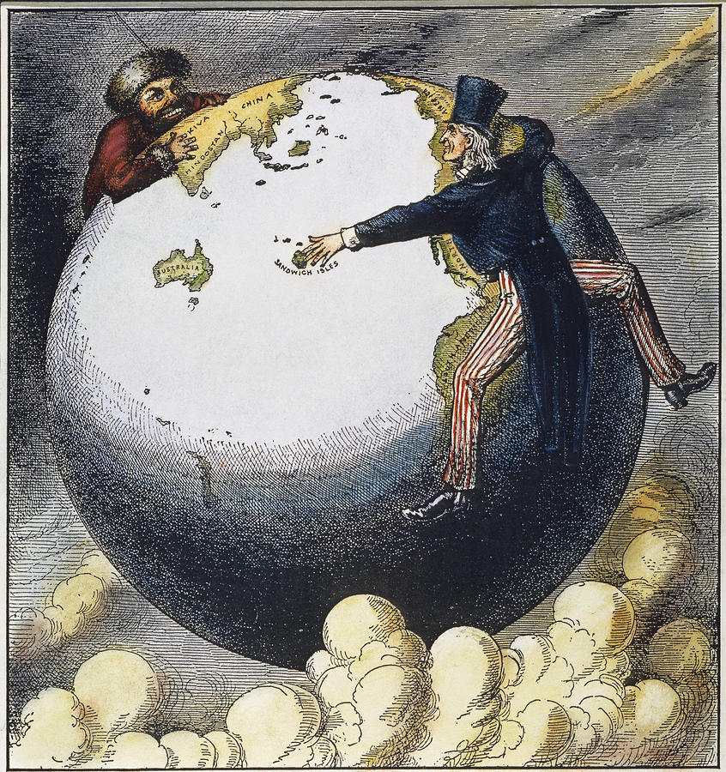
Imperialism is…
When strong nations extend their political, military, and economic control over weaker territories.
Is it cool to practice imperialism? Why?

Slide 6
Section 1: The Roots of Imperialism
During the late 1800s, the US begins abandoning isolationism and seeks to become a global power by gaining influence and territory outside it’s continental borders.

Slide 7
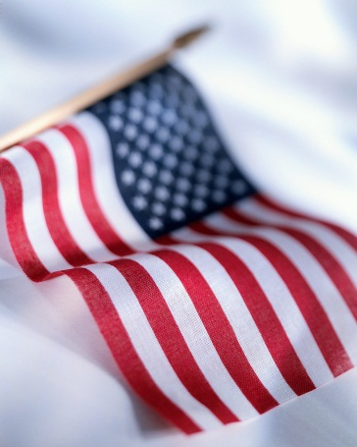
Causes of Imperialism
Economic Benefits
  US was seeking new markets to sell goods to
Military Strength
  Need for foreign bases for the US’s growing navy
National Superiority
  America wanted to compete with European imperial powers

Slide 8
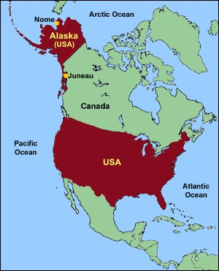
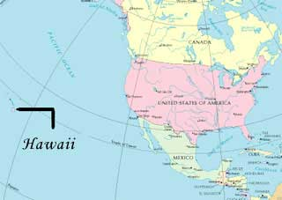
America’s 1st Steps Toward World Power
US opens trade with Japan (1853)
US buys Alaska from Russia, gaining access to many resources and expanding its reach in the Pacific Ocean (1867)
US acquires the islands of Hawaii (1898)

Slide 9
Quick Discussion
How might one argue imperialism is acceptable / unacceptable?

Slide 10
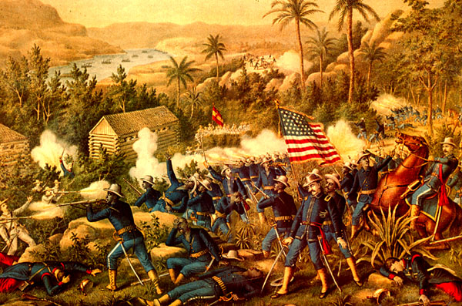
Section 2: The Spanish-American War
In 1898, the US went to war with Spain. The result… the US acquires new colonies and becomes a world power.

Slide 11
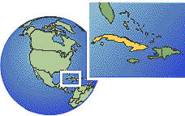
Causes of the Spanish-American War
US supports Cuba as a colony in rebellion against Spain.
An American ship, the Maine, explodes in Cuba, killing hundreds. Most Americans blame Spain.
The US Navy blockades Cuban ports, causing Spain to declare war.
Cuba

Slide 12
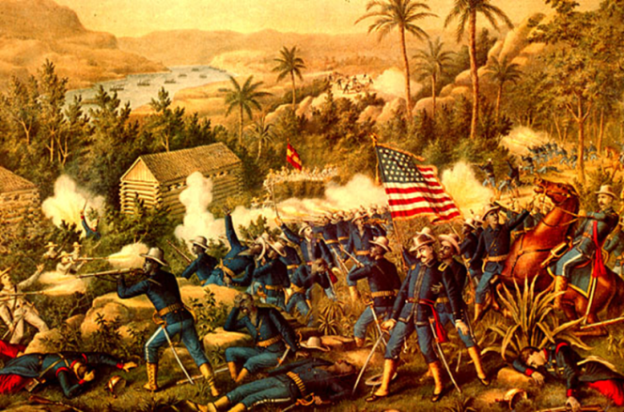
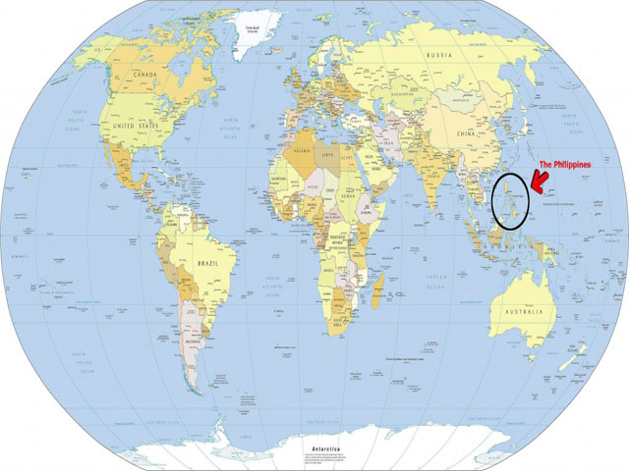
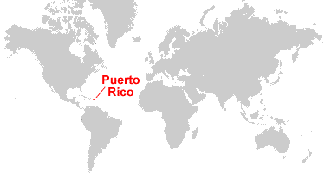
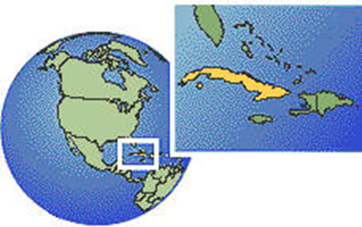
American Troops Battle the Spanish
US Forces attack and defeat Spanish forces in the Philippines, Cuba, and Puerto Rico
Philippines
Cuba

Slide 13

Effects of the War
Question: What to do with Spain’s former possessions?
Answer: The US gains Cuba, Puerto Rico and Guam. Spain sells the Philippines to the US.
*The Result of the Spanish-American War = the US gains new territory and stature in world affairs.

Slide 14

Quick Discussion
What might be the benefits / challenges of the US acquiring new territory such as Cuba, Puerto Rico, Guam and the Philippines?

Slide 15

Section 3: The United States and East Asia
*Imperialism in East Asia brought greater power and wealth to America, but it also increased international tensions in Asia.

Slide 16
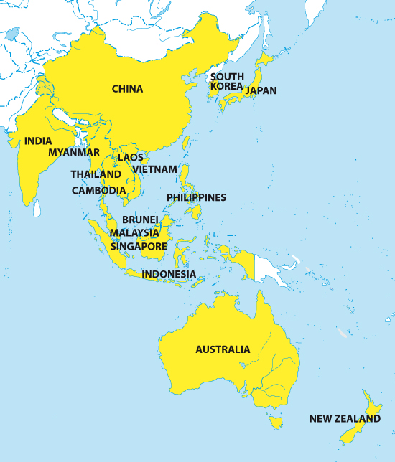
The US and East Asia
Filipinos Rebel Against US Rule
  Guerrilla Warfare breaks out (US forces win)
  US promises future independence to the Philippines
The US Pursues Interests in China
  Open Door Policy: Seeking Free Trade with China
Tensions Rise between America and Japan
  US prepares its military as Japan forcefully
  expands into China, Korea, and Russia

Slide 17
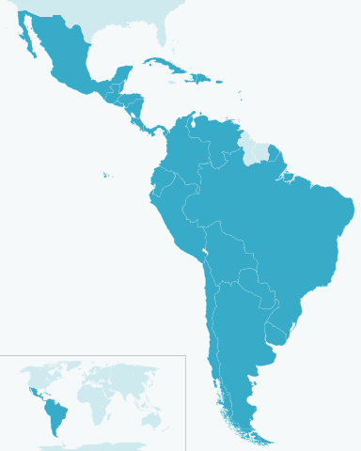
Section 4: The US and Latin America
US influence in Latin America brought benefits to entrepreneurs (businessmen) and government leaders, but it also contributed to anti-American hostility and instability in the region.

Slide 18
Different Methods in Latin America
President Theodore Roosevelt (1901 – 1909) pursues ‘Big Stick’ Diplomacy
  US needed to use its power to forcefully uplift weaker nations
  Accomplishment: US Builds the Panama Canal
President Wilson (1913 – 1921) Pursues Moral Diplomacy
  US should avoid imperialism and work to promote ‘human rights, national integrity, and opportunity.’

Slide 19
Quick Discussion
Is there ever a time that the US should use force to influence another nation? Why?

Slide 20
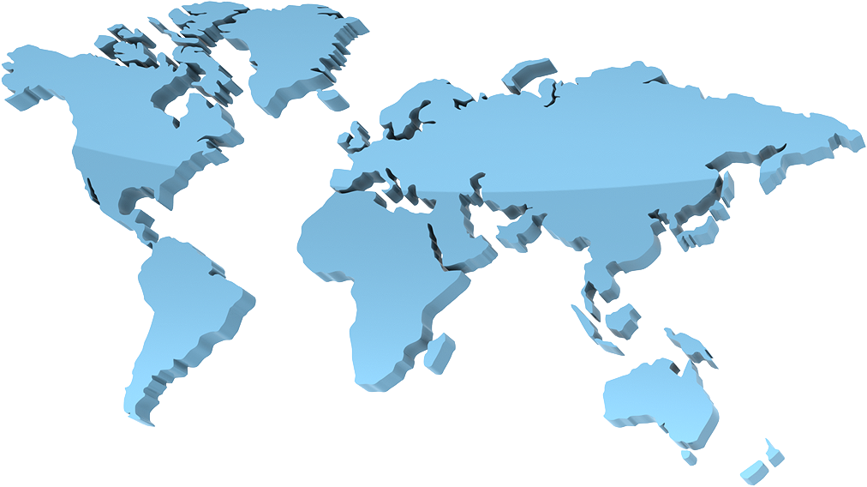
Concluding Thought
US victory over Spain and US influence in Asia and Latin America showed that America was emerging as a world power.

Slide 21

Summarizing Discussion Questions
What is imperialism and is it a good policy? Why?
What are some examples of American imperialism during the late 1800s – early 1900s?
The practice of imperialism is practically condemned or looked down upon throughout most of the world today. Why do you think that is?

