Slide 1
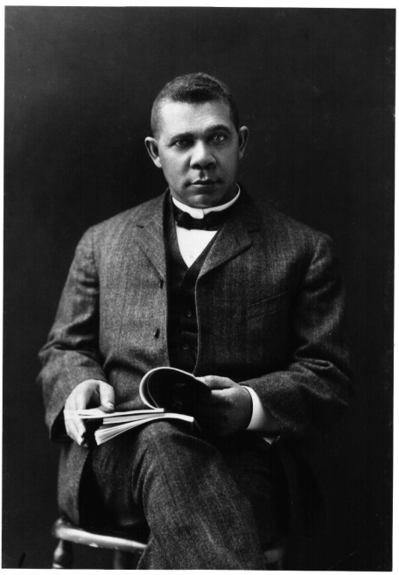
Unit 5: Life in Post-Slavery America
(1875 – 1928)
During the late 1800s and early 1900s African-Americans struggled to find their place in the United States, while also seeking ways to express their voice and culture.
Booker T. Washington (1856 – 1915) serves as an example of blacks trying to earn their success and prove their worth in America during this time period.

Slide 2
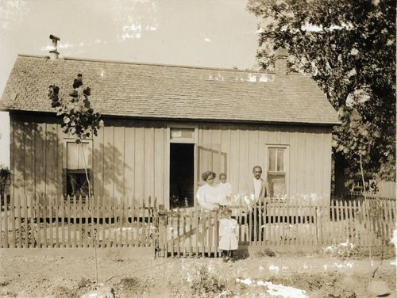
Chapter 14: African-Americans in the South in the Late 19th Century (1875 – 1900)
In the years following Reconstruction, African-Americans faced many difficulties and injustices, especially in the South.

Slide 3
Section 1: Politics
After Reconstruction ended in 1877, some black politicians stayed in office. However, by 1900 the political system in the South was virtually all white.
What impact do you think this had on life in the South for whites and for blacks?

Slide 4
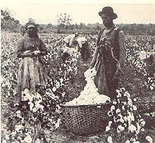
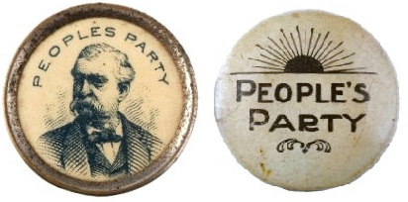
Section 1: Politics
Black farmers did form alliances to protect their political and economic interests.
Many of these alliances supported the new Populist Party (People’s Party), a political party that sought to be a voice for the common people, such as farmers.

Slide 5
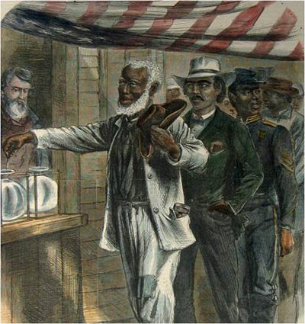
Section 2: Disfranchisement
Disfranchisement: to deprive of the right to vote
During the late 19th century, southern Democrats increased their efforts to prevent black men from exercising their right to vote.
Why?
Examples of Tactics to Prevent Blacks from Voting
Literacy Tests: if you can’t pass a reading test then you can’t vote
Grandfather Clauses: if you or your father / grandfather couldn’t vote before 1867, then you couldn’t vote

Slide 6
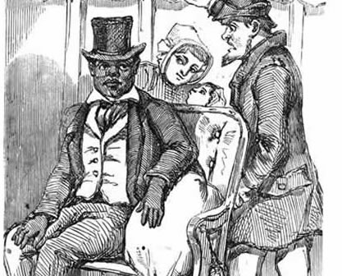
Section 3: Segregation
Segregation evolved into a system of white control.
The Supreme Court case of Plessy vs. Ferguson established the legal principle of ‘separate but equal’ public facilities. (hotels, parks, etc.)
  This helped clear the way for further legal segregation.
Plessy vs. Ferguson
In 1892 and in the state of Louisiana, Homer Plessy bought a train ticket. The problem is Plessy was black (though only 1/8th black) and his seat was designated for whites only. Plessy was arrested for violating a segregation law. His case went all the way to the Supreme Court, where it was decided that’s Louisiana’s segregation law should be upheld.

Slide 7
Quick Discussion
Imagine yourself to be a lawyer in the late 19th century.
How could you argue for ‘separate but equal’ segregation?
How could you argue against ‘separate but equal’ segregation?

Slide 8
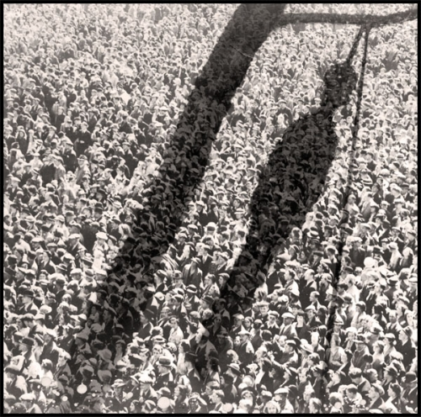
Section 4: Violence
Political and mob violence continued during the 1880s and 1890s, as Democrats often used armed force to drive blacks and white Republicans out of politics.
Lynching was common, averaging 2 or 3 a week, and usually done in the South.
Lynching was often justified as punishment for the alleged rape of a white women by a black man. However, the rape of a black woman was almost never punished.

Slide 9
Quick Discussion
While lynching was not legal, it was common during the late 1800s and early 1900s.
How does this help us better understand life in the US during this time?

Slide 10
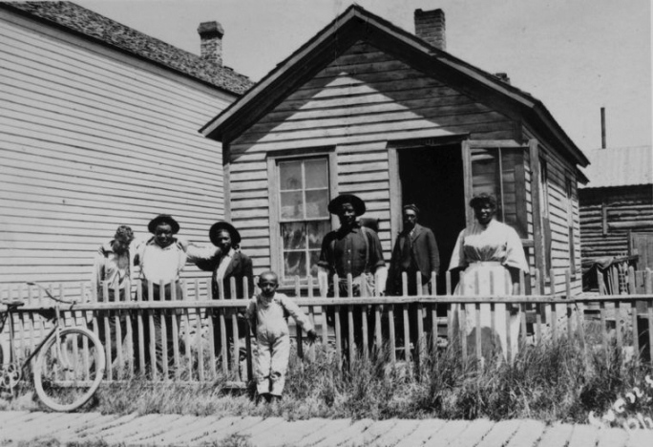
Section 5: Migration
In the face of violence, discrimination, and poverty, thousands of blacks decided to leave the South.
Blacks hoped for better opportunities out West, up North, or at least in southern cities rather than in rural areas of the South.
Blacks who migrated westward became known as Exodusters.

Slide 11
Section 6: African Americans and Southern Courts
As the legal system became increasingly white, blacks accused of breaking the law could have little to no expectation of justice and fair treatment.
Blacks were almost always convicted and faced harsher sentences than whites who committed similar crimes.

Slide 12

Quick Review of Ch. 14
African-Americas in the South in the Late 19th Century
What kind of difficulties and injustices did blacks face in the South during the late 19th century?
How was it possible that these injustices took place?
How do you think these kind of challenges have impacted the development of life for African-Americans over the last 100 years?

