Slide 1
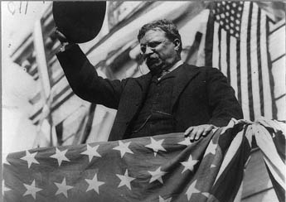
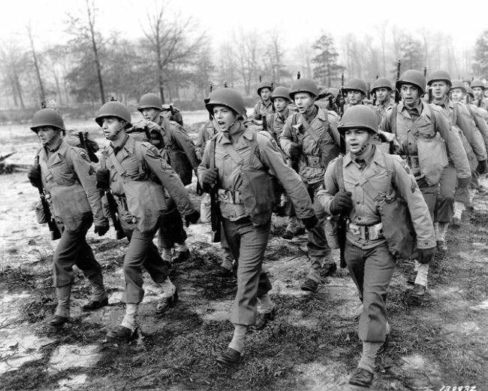
Unit 5: Emergence of the Modern United States (1890 – 1920)
The United States makes progressive changes in it’s government at home while beginning to become a global power abroad through imperialism and involvement in World War 1.

Slide 2

Chapter 13: The Progressive Era
1890 - 1920
Progressives believed that industrialization and urbanization had created social and political problems. They wanted to bring changes that would correct these problems and injustices.
Theodore Roosevelt served as President from 1901 – 1909. He supported the Progressive Movement.

Slide 3
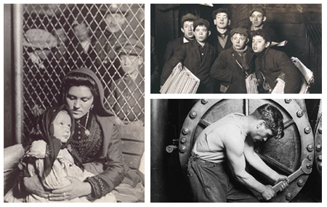
Section 1: The Drive for Reform
Progressives believed that new ideas and honest, efficient government could help meet the challenges of social problems.
Problems Progressives Targeted
  Women’s Suffrage
  Dishonest Government
  Poor Housing in Crowded Cities
  Fear of Unfair Big Business
  Helping the Poor

Slide 4
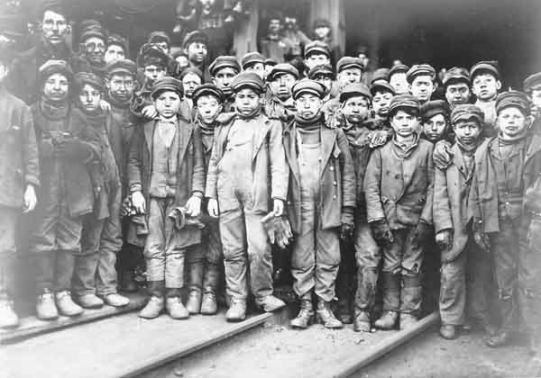
Progressives Reform Society
Promoted laws to improve living conditions for the poor
Helped children by fighting to ban child labor and require states to provide education
Fought to improve safety for workers and provide $ for those hurt on the job

Slide 5

Discussion Question
Progressives sought to find solutions to social problems of their day. What social problems do you think need attention in modern times?

Slide 6
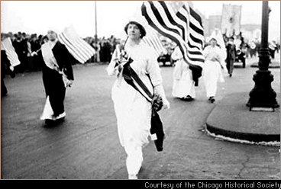
Section 2: Women Make Progress
In the early 1900s, women activists get involved in the Progressive movement.
  More women begin working outside the home in factories.
  They promoted safe, fair, and healthy working conditions
  They pushed for laws to help mothers keep their families healthy and safe

Slide 7
Women Fight for the Right to Vote
Women gave speeches, lobbied Congress, and even protested outside the White House. However, it was their support of the US war effort during World War 1 that finally convinced legislators to support the right to vote for women.
1920 – the 19th Amendment stated that one could not be denied the right to vote based on their sex

Slide 8
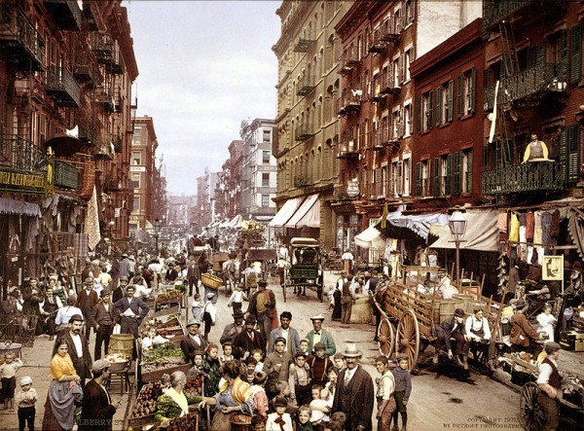
Section 3: The Struggle Against Discrimination
Despite the Progressive Movement, prejudice and discrimination continued.
  Minorities such as African-Americans, Latinos, Catholics, Jews and new immigrants attempted to stand up for their rights.
  Their efforts would pave the way for the civil rights movement later during the 1960s.

Slide 9
Quick Discussion
Why do you think there always seems to be some form of discrimination against people as we study US History?

Slide 10
Section 4: Roosevelt’s Square Deal
In 1901, Theodore Roosevelt is elected president.
After many weak presidents, he emerges as a strong and charismatic leader.
He pushes Progressive reforms and expands the powers of the presidency.

Slide 11
Roosevelt’s Square Deal
Square Deal = ‘Fair Deal’
His goals were to keep the wealthy and powerful from taking advantage of small business owners and the poor.
  Set limits on the cost of railroad shipping
  Broke up large corporations if they were cheating consumers
  Regulated the food and drug industries

Slide 12
Section 5: Wilson’s New Freedom
Democratic President Woodrow Wilson uses his time in office to continue progressive reform efforts.
He seeks to give the government more control of the economy by attacking what he saw as ‘the triple wall of privilege’
  Tariffs (taxes on imports)
  Banks
  Trusts (Large Companies Working Together)
Wilson believed tariffs, banks and trusts were blocking businesses from being free.

Slide 13

Progressivism Leaves a Lasting Legacy
Increased the influence of voters
Government becomes more involved in individuals lives
Government increases its regulation of business and of natural resources
*Passed on the idea that government can take action to help people fix social problems.

Slide 14

Quick Review
What was the goal of Progressives and how did they go about trying to achieve it?
Why do you think it took until 1920 for all women to have the right to vote?
How would you describe Theodore Roosevelt and his presidency?
What impact have Progressives left on US government?

