Slide 1
Review Game
What’s on the ppt?
Chapters 11 - 13

Slide 2
‘What’s on the ppt?’ Rules
2 Teams are Competing
1 Teammate will have his / her back turned to the ppt
Teammates will have 30 seconds to try to describe what is on the ppt, but YOU CAN’T SAY ANY OF THE WORDS ON THE PPT
If the Teammate can guess what’s on the ppt, your team get’s a point!
Whoever ends with the most points wins!

Slide 3
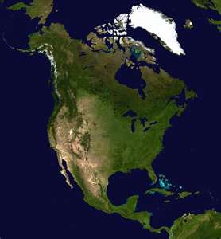
Example
The word is ‘North America’
Teammates can not say ‘North’ or ‘America’
Also, no rhyming or starts with ‘N’

Slide 4
Civil War

Slide 5
President Lincoln

Slide 6
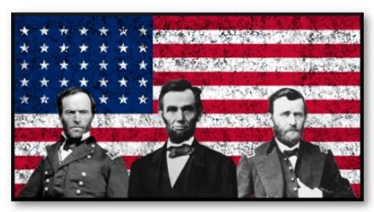
Union

Slide 7
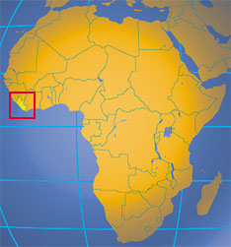
Colonization

Slide 8

Emancipation

Slide 9
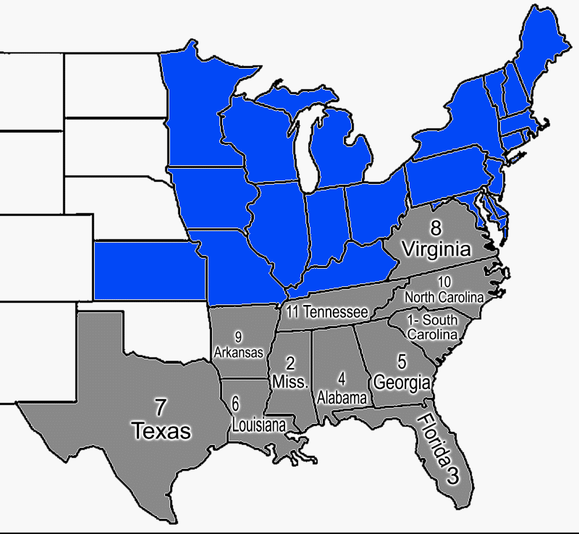
Confederacy

Slide 10

Abolition

Slide 11
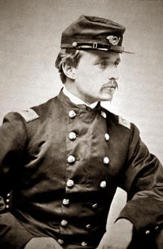
Robert Shaw

Slide 12

Liberators

Slide 13
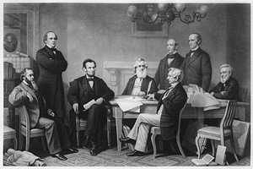
Emancipation Proclamation

Slide 14
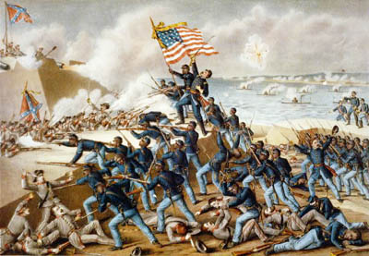
54th Massachusetts Regiment

Slide 15
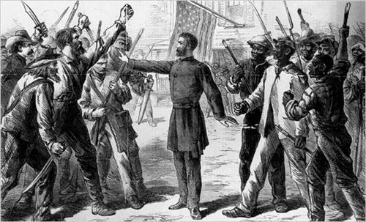
Reconstruction

Slide 16
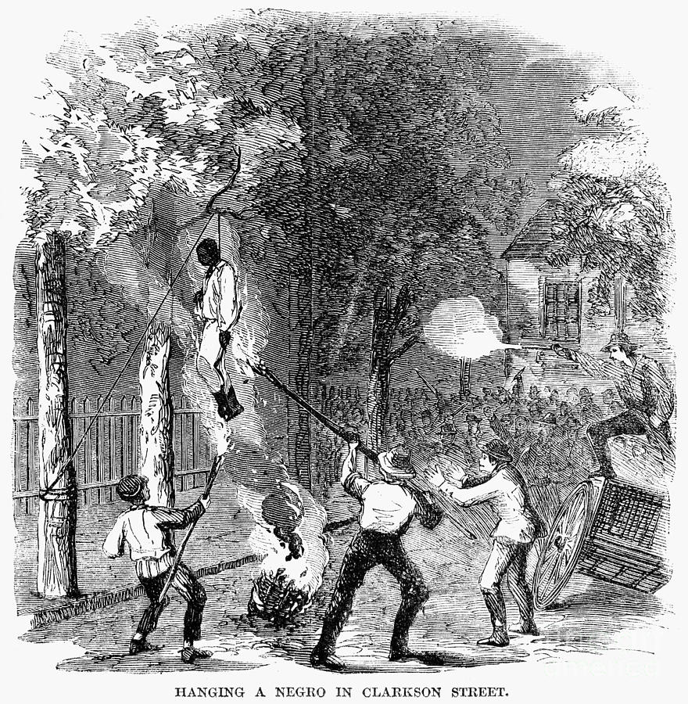
New York City Draft Riots

Slide 17
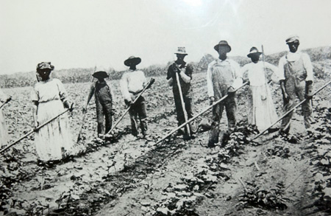
Sharecropping

Slide 18
13th Amendment

Slide 19

Freedom and Education

Slide 20
Civil Rights

Slide 21
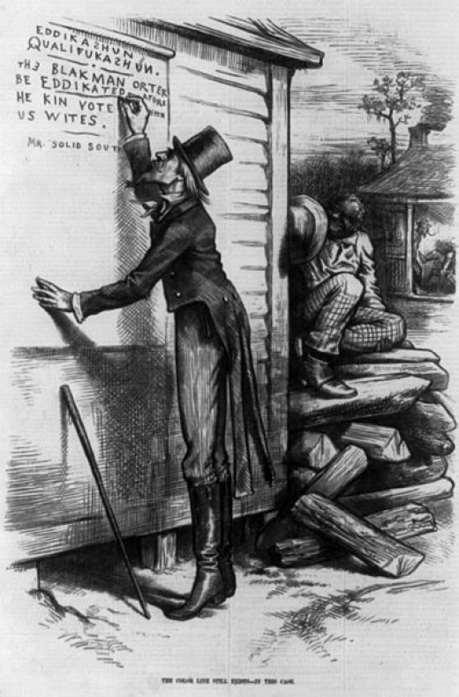
Black Codes

Slide 22
President Andrew Johnson

Slide 23
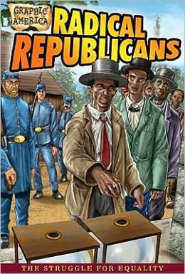
Radical Republicans

Slide 24
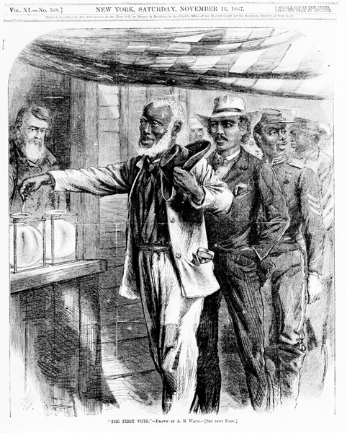
14th Amendment

Slide 25
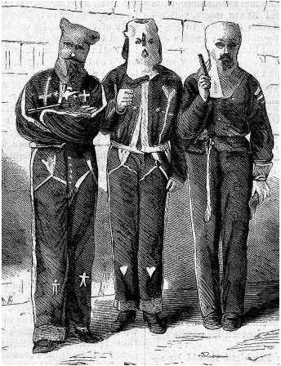
Ku Klux Klan

Slide 26
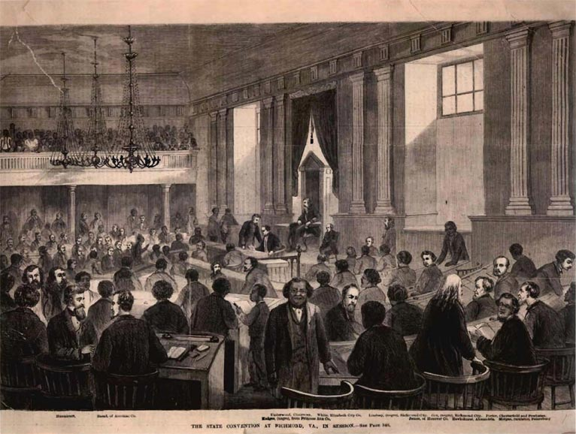
Constitutional Conventions

Slide 27
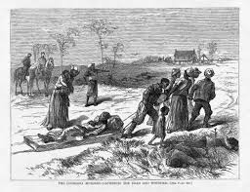
Enforcement Acts

Slide 28
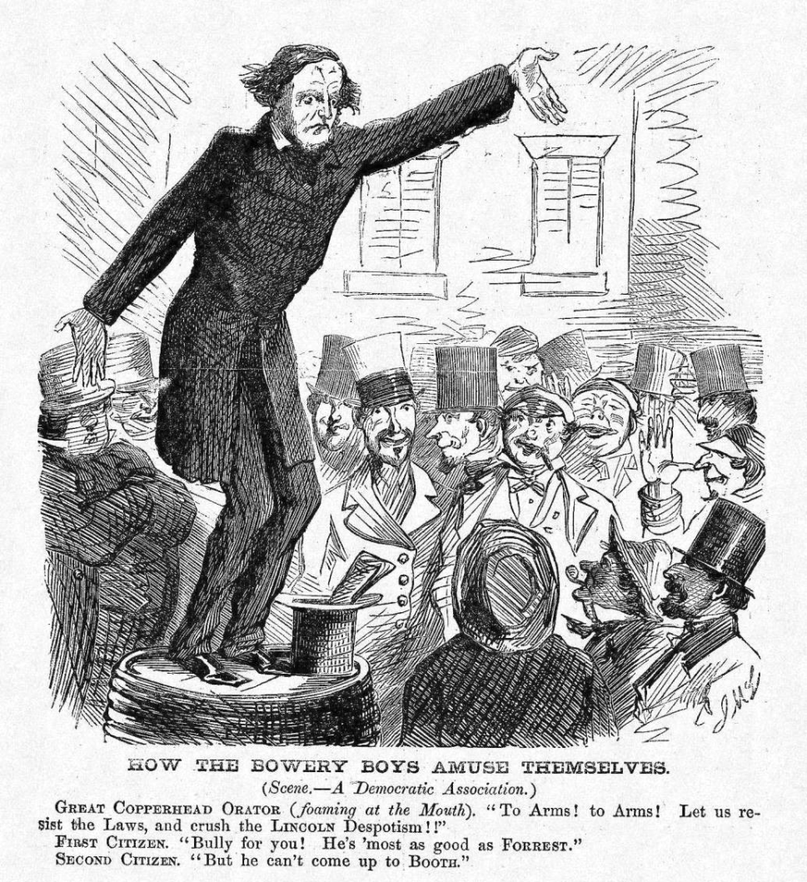
Democratic Party

Slide 29
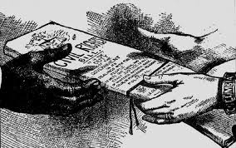
Civil Rights Act of 1875

Slide 30
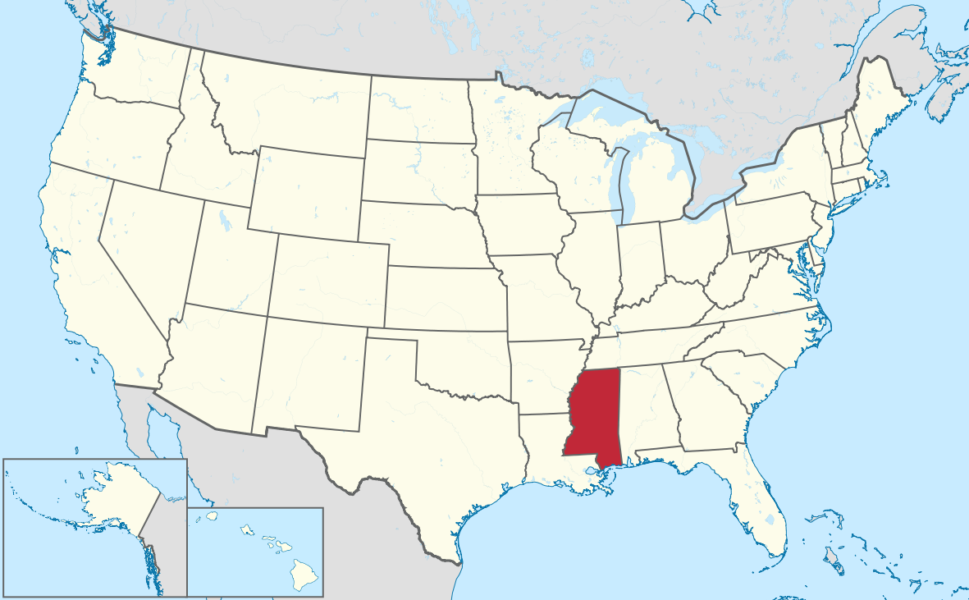
Mississippi Shotgun Policy

Slide 31
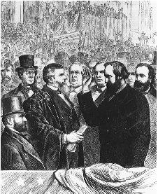
Compromise of 1877

