Slide 1
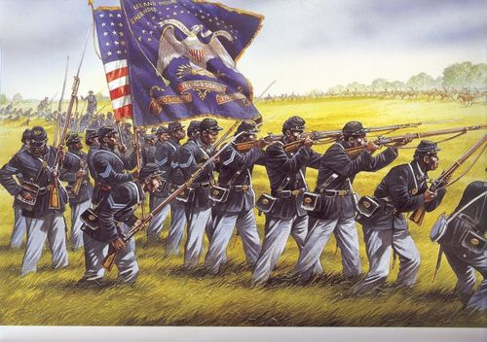
Unit 4
African-Americans During the Civil War and Reconstruction Era
The question of slavery is finally settled during the Civil War. In the following years African-Americans will pursue greater equality as free American citizens.

Slide 2

Quick Review of Ch 11 and Ch 12
How did the Emancipation Proclamation change the war?
How were African Americans involved in the Civil War?
How would you describe life for newly freed slaves in the years after the Civil War?
Can you compare President Johnson’s approach to Reconstruction with the Radical Republican’s approach?

Slide 3
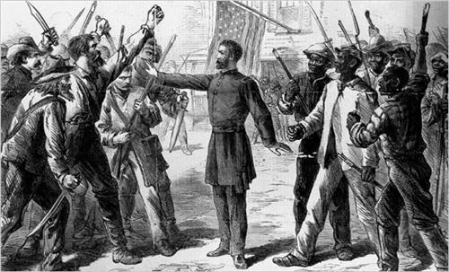
Ch. 13: The Failure of Reconstruction
(1868 – 1877)
While southern blacks gained some political influence during the Reconstruction Era, they were unable to truly gain equality and civil rights.

Slide 4
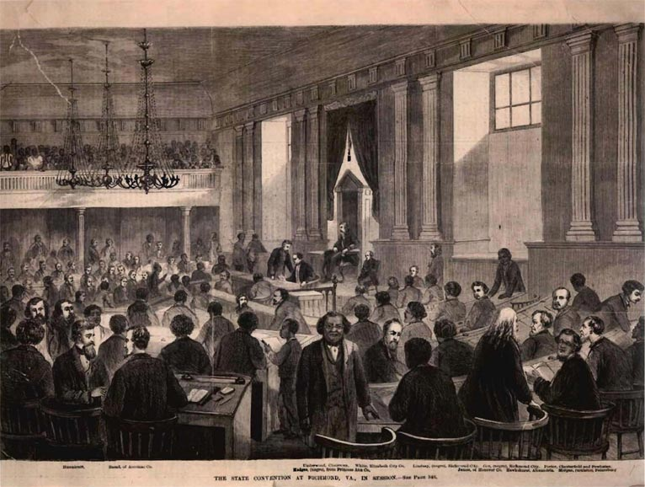
Section 1: Constitutional Conventions
In 1867 and 1868 constitutional conventions met in the former Confederate states to make necessary adjustments to state constitutions.
  About 25% of the conventions delegates were black.

Slide 5
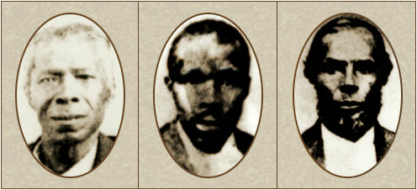
Section 1: Constitutional Conventions
Black leaders served in a variety of political offices.
Their priorities were…
  Education
  Civil Rights
  Economic Opportunity
3 of 10 Black Delegates for the Constitutional Convention in Texas.
Why was it important to include blacks as delegates for these constitutional conventions in the South following the end of the Civil War?

Slide 6
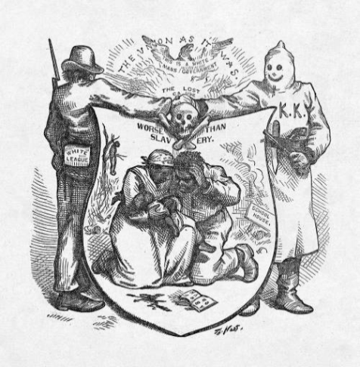
Section 2: Black Politicians Struggle
The Republican Party (Lincoln’s Party) struggled during Reconstruction
  Disagreements among black leaders and Republican factionalism (they couldn’t remain united)
  Strong opposition from white southerners in the Democratic Party
    Sadly, this opposition so desperately wanted to restore white political power that they were willing to resort to violence and terror through groups like the Ku Klux Klan (KKK).

Slide 7
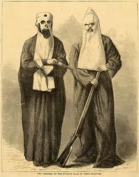
Quick Discussion
The Ku Klux Klan used threats, beatings, rapes and even murder in an effort to force black people back into subordination and restore conservative white Democratic rule. In modern times we see the KKK as a terrible thing. How do you think it was possible that people actually supported this during the late 1800s?

Slide 8
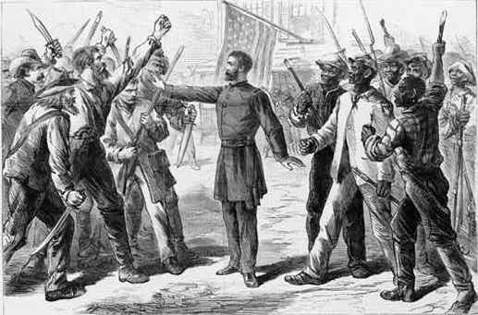
Section 3: Protecting Civil Rights
Congress passed the Enforcement Acts in 1870 and 1871 in an effort to stop the rising violence in the South against blacks and Republican officials.
  The Acts had limited success.

Slide 9
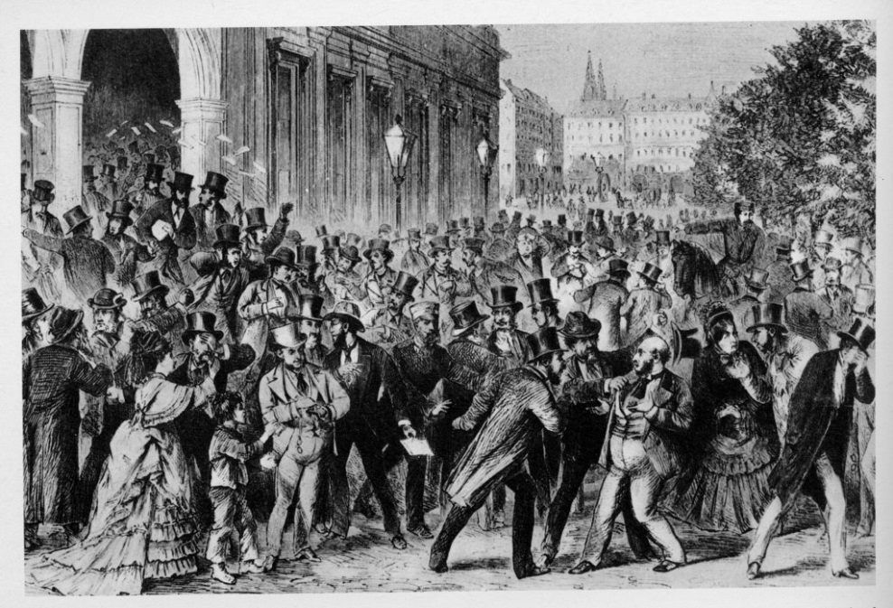
Section 3: Protecting Civil Rights
By the early 1870s, many in the North were losing interest in the Reconstruction process taking place in the South.
  Rather they became focused on elections and economic concerns in the North.
The Panic of 1873 was a financial crisis that sent the US economy into a slump. It encouraged the North to turn its eyes away from Reconstruction and focus more on economic matters.

Slide 10
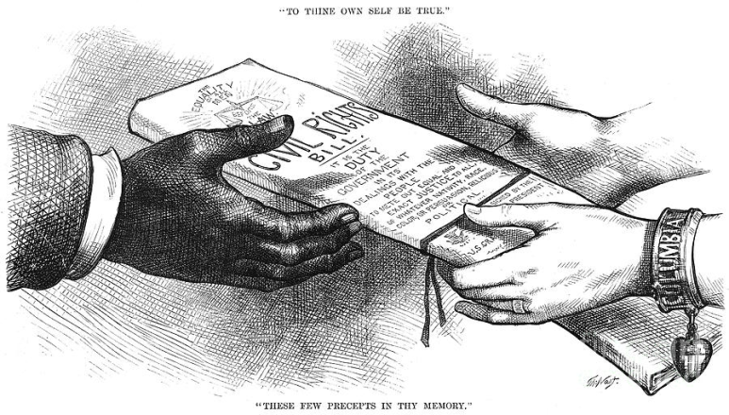
Section 3: Protecting Civil Rights
The Federal Government made a final attempt to protect the rights of black people with the Civil Rights Act of 1875.
  Intended to open public accommodations (schools, hotels, trains) to people of all races.
  However, its provisions were never enforced and it was declared unconstitutional in 1883.

Slide 11
Quick Discussion
Can you think of some ways that 20th century American history might have been different if African-Americans had gained full legal equality and civil rights during the Reconstruction Era?

Slide 12
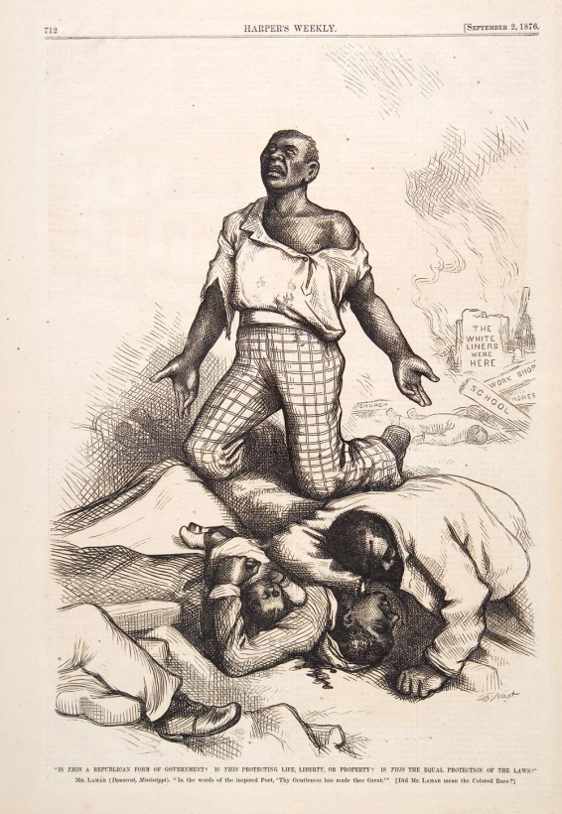
Section 4: The End of Reconstruction
Democrats were determined to ‘redeem’ the South, meaning they wanted to return southern states to conservative white political control.
In the state of Mississippi this determination resulted in the ‘Shotgun Policy’, meaning that whites used extreme measures of violence against blacks and Republicans to regain political control.

Slide 13
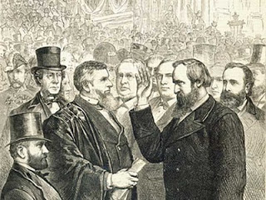
Section 4: The End of Reconstruction
The Compromise of 1877 marked the end of Reconstruction
  A Republican President was elected
  Southern states were now being led by white Democrats
  Federal troops withdrew from the South
Henry Adams, a black leader from Louisiana, stated, “Every state in the South had got into the hands of the very men that held us as slaves.”

Slide 14

Quick Review of Ch. 13
The Failure of Reconstruction
What were the top priorities of newly appointed black leaders in the South?
What are the reasons why the federal government failed to establish equality and civil rights for blacks in the South during the period of Reconstruction?
How would you describe the situation in the South by the end of Reconstruction?

