Slide 1
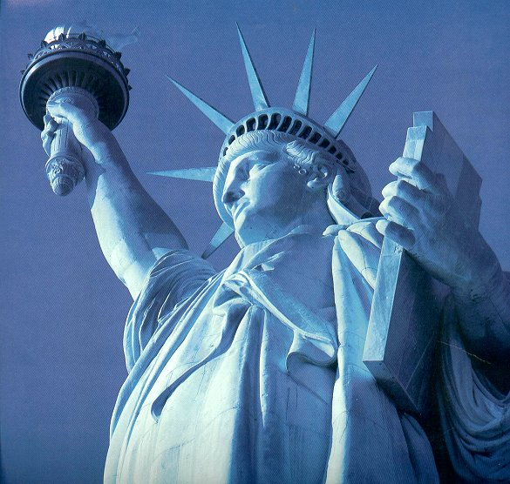
Unit 1: Foundations of Citizenship

Slide 2
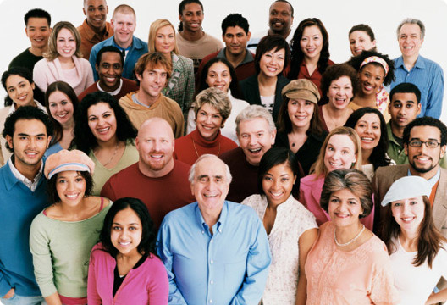
Chapter 1 Notes
A Portrait of Americans

Slide 3
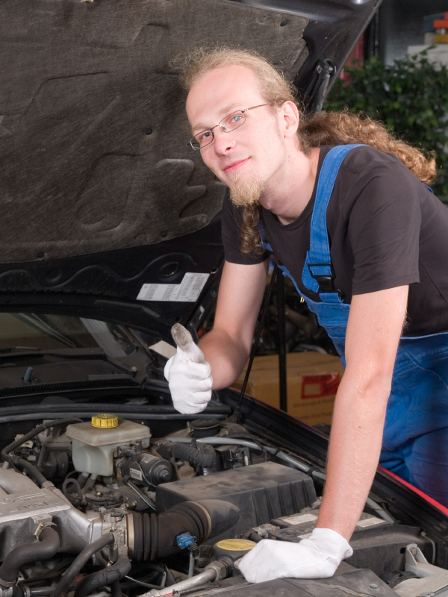
Who Americans Are
4/5 live in Urban Areas
Workforce – about 60 million women and 70 million men
  75% are service jobs
Increase in older Americans

Slide 4
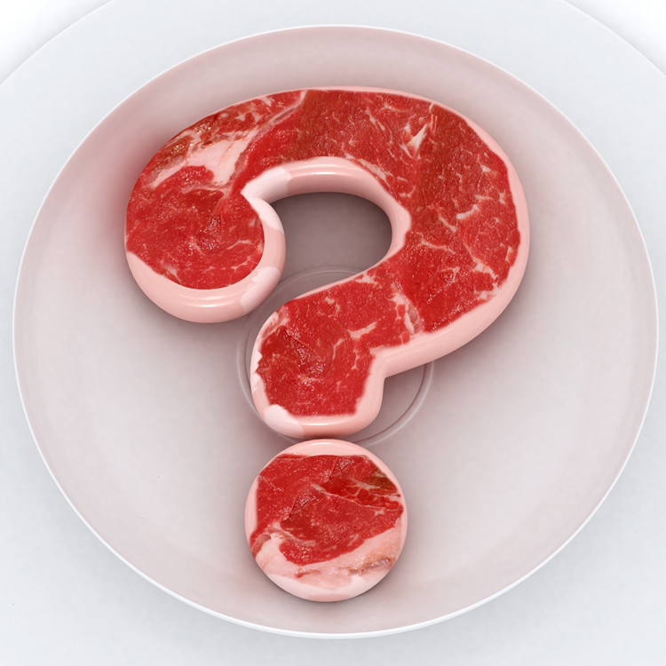
What is a mosaic?

Slide 5
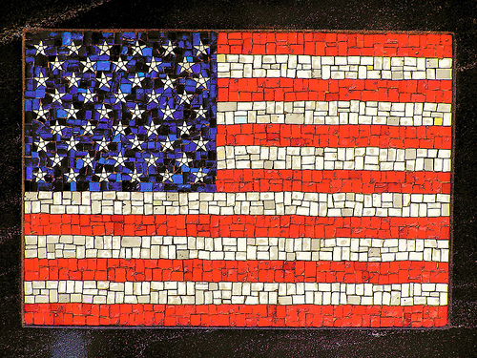
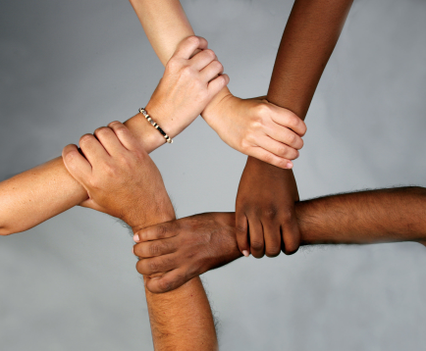
America: A Cultural Mosaic
Diversity
European Americans
Hispanic Americans
African Americans
Asian Americans
Native Americans

Slide 6
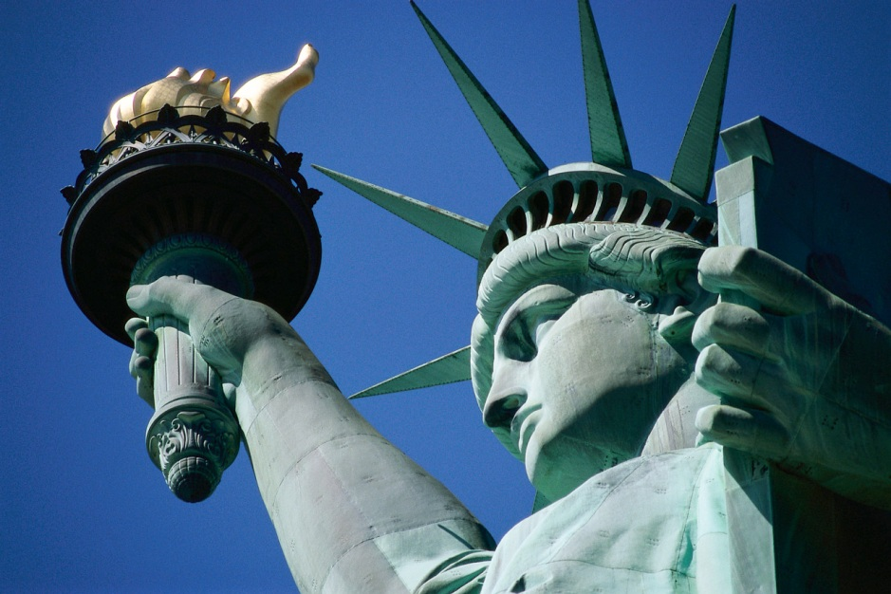
The Values that Unite Us
Equality
Equal Opportunity
Freedom
Justice

Slide 7
Discussion Questions
What are the benefits of diversity in the US?
What are the challenges of diversity in the US?

Slide 8
Quick Write
5 values I believe in are…

Slide 9
Class Exercise
Write out the questions and your answers based on the textbook and your notes.
Turn in for a classwork grade when completed.
Ch. 1 Review and Assessment, page 26
# 1 - 11

Slide 10
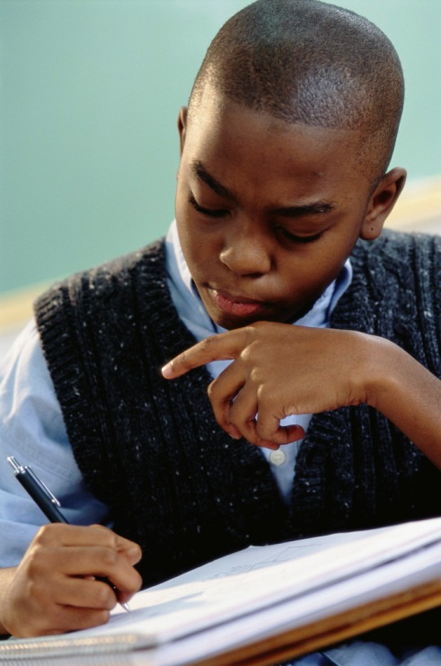
Homework
Write at least a paragraph to respond to the following question.
‘What are your values and where did you get them from?’

