Slide 1

Review Game
What’s on the ppt?
Chapters 8 - 12

Slide 2
‘What’s on the ppt?’ Rules
2 Teams are Competing
1 Teammate will have his / her back turned to the ppt
Teammates will have 30 seconds to try to describe what is on the ppt, but YOU CAN’T SAY ANY OF THE WORDS ON THE PPT
If the Teammate can guess what’s on the ppt, your team get’s a point!
Whoever ends with the most points wins!

Slide 3
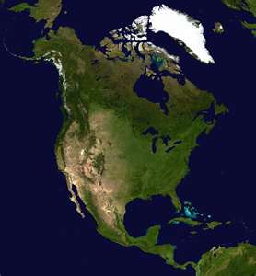
Example
The word is ‘North America’
Teammates can not say ‘North’ or ‘America’
Also, no rhyming or starts with ‘N’

Slide 4

Budget

Slide 5
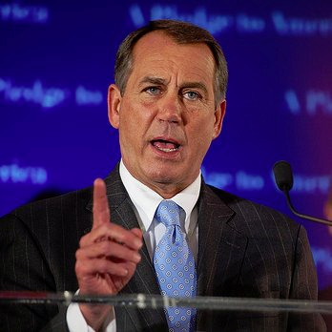
Speaker of the House

Slide 6
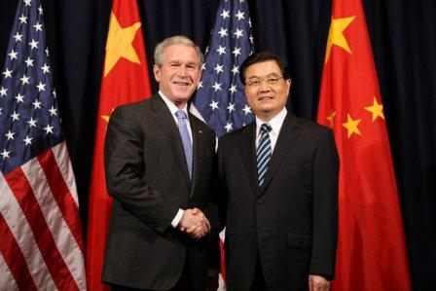
Ambassador

Slide 7
Interest Group

Slide 8
Constituents

Slide 9
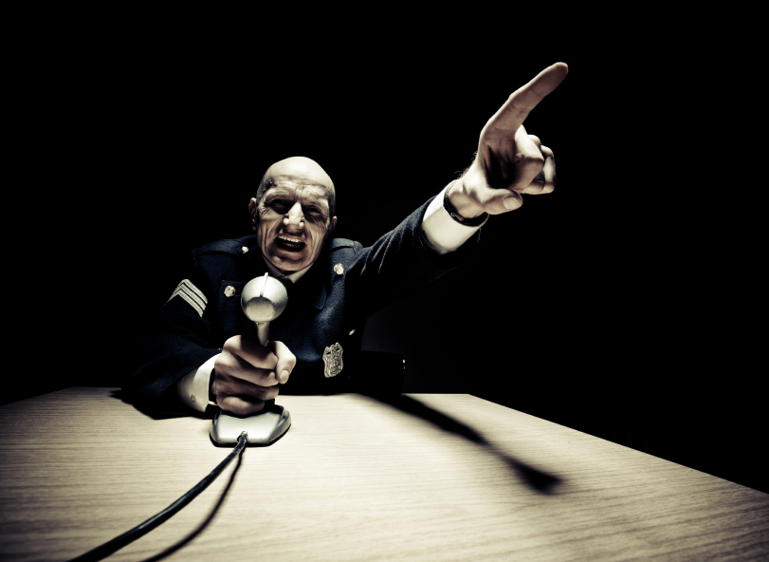
Filibuster

Slide 10
Lobbyist

Slide 11
Precedent

Slide 12
Floor Leaders

Slide 13
Appeal

Slide 14
Pocket Veto

Slide 15

Domestic Policy

Slide 16
Board

Slide 17
Property Tax

Slide 18
Cloture

Slide 19
Bureaucracy

Slide 20
Executive Branch

Slide 21
Treaty

Slide 22
Public Policy

Slide 23
District Attorneys

Slide 24

Administration

Slide 25
Cabinet

Slide 26
Executive Privilege

Slide 27
Plaintiff

Slide 28
Original Jurisdiction

Slide 29
Referendum

Slide 30
Utilities

Slide 31
Defendant

Slide 32
Municipality

Slide 33
Prosecution

Slide 34
Council of State

Slide 35
Court of Appeals

Slide 36

Local Charter

Slide 37
Judicial Review

Slide 38
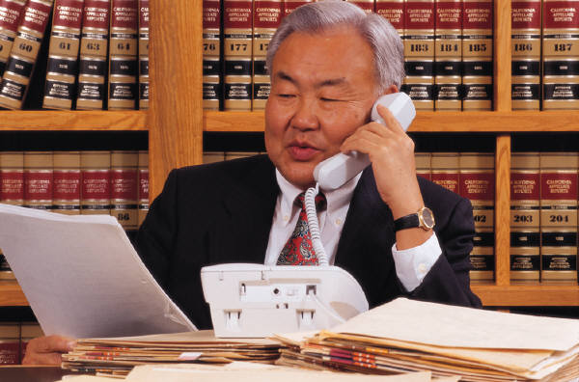
Initiative

Slide 39
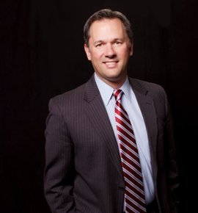
Lieutenant Governor

Slide 40
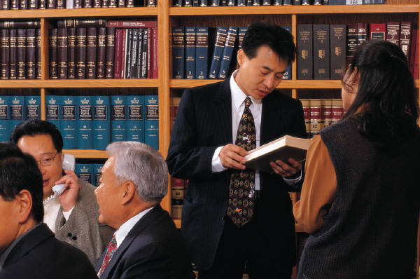
Ordinance

Slide 41
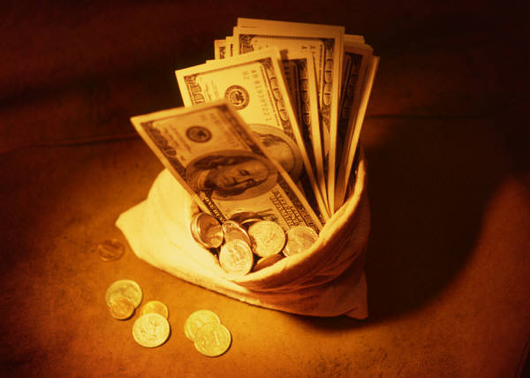
Grants

Slide 42
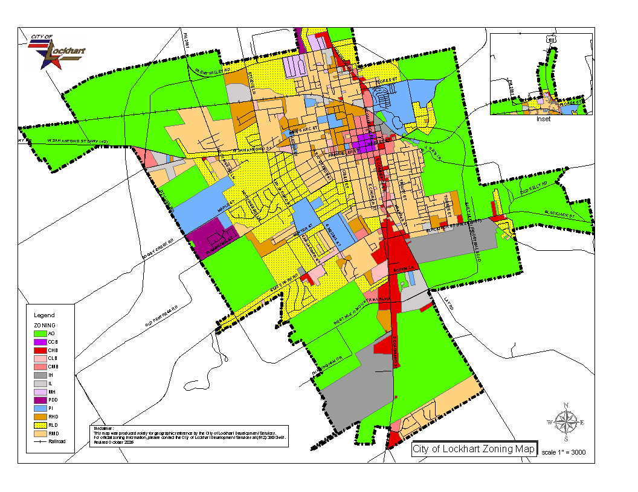
Zoning

Slide 43
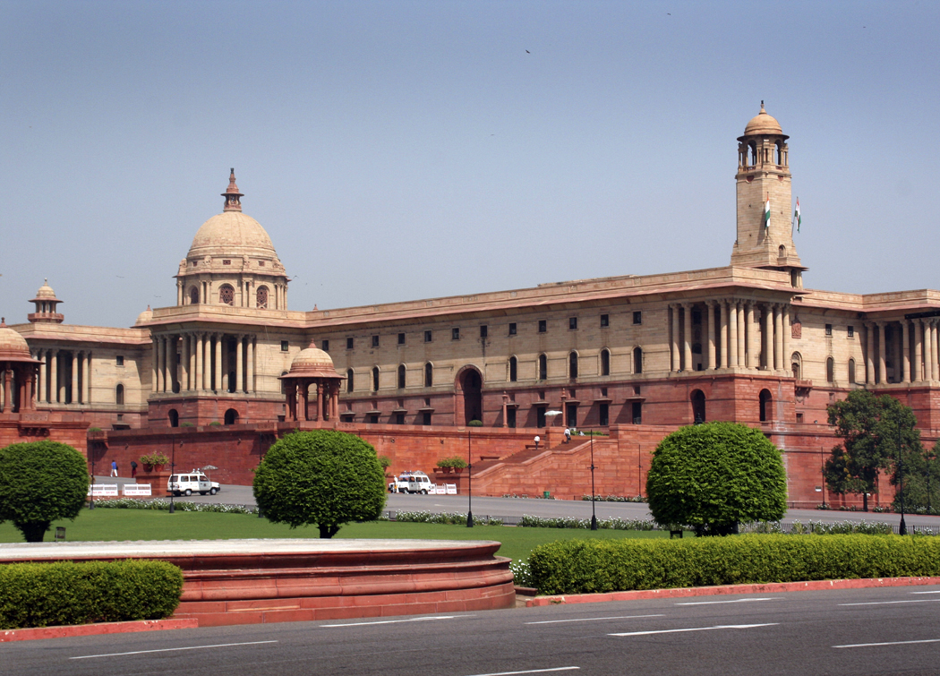
Councils of Governments

Slide 44
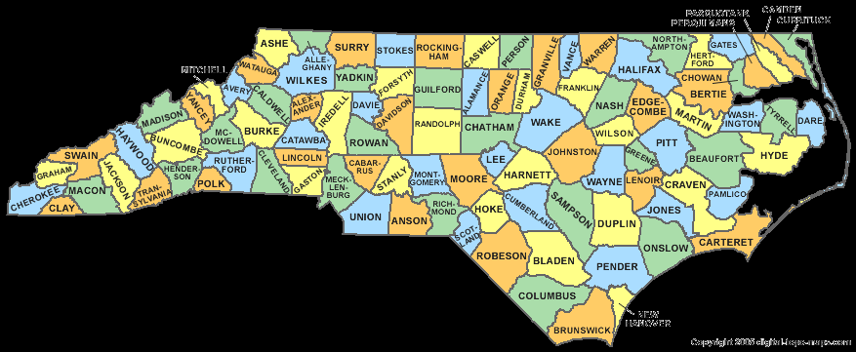
Gerrymandering

