Slide 1
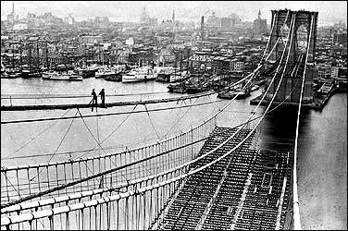
Unit 4: Industrialization of the United States (1865 – 1914)
During the late 19th and early 20th century the US continues to build industry while it also continues its expansion westward.
The building of the Brooklyn Bridge. (Completed in 1883)

Slide 2
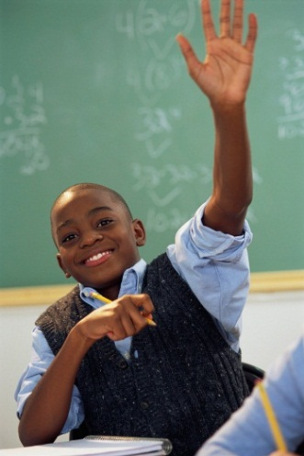
Quick Review of Ch. 9 - 11
What were the reasons for workers organizing labor unions?
How would you describe city life in the late 1800s and early 1900s?
What kind of changes were taking place in the South / West during this time?

Slide 3
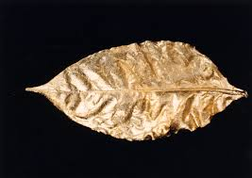
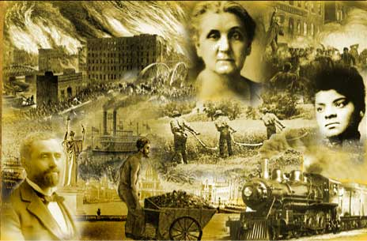
Ch. 12: Issues of the Gilded Age
(1877 – 1900)
The term Gilded Age came to define an era in which excessive extravagance and wealth concealed mounting social problems, government corruption, and poverty.
Gilded
  To cover thinly with gold
  To give a deceptively attractive appearance

Slide 4
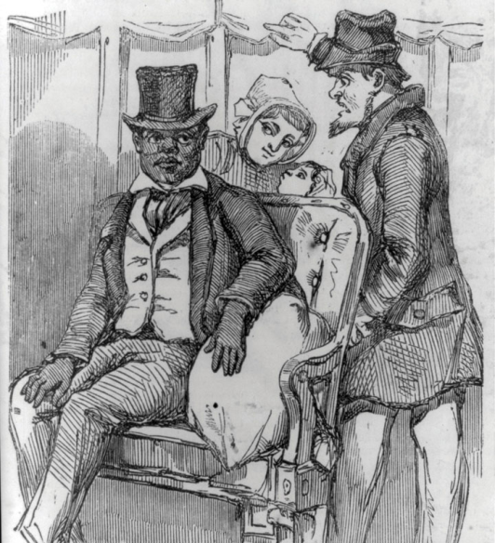
S1: Segregation and Social Tensions
In the years following Reconstruction, African-Americans and other minorities were unable to maintain equal rights.
This turn away from equality had a lasting impact on society in the US.

Slide 5

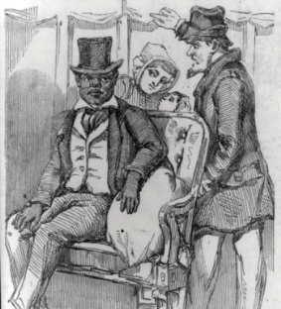
Discrimination
African-Americans
  Southern States Limit Voting Rights for Blacks
    Poll Tax: Voters pay a tax to vote but poor African-Americans can’t afford it.
    Literacy Tests: Required voters to pass a reading test, but many African-Americans were denied an education.
    Grandfather Clause: Allowed a person to vote as long as his ancestors had voted before 1866.
  New ‘Jim Crow’ Laws Force Segregation
    Whites and blacks separated in public places, such as restaurants, parks, and hospitals.

Slide 6
Discrimination
Chinese Immigrants
  Chinese Exclusion Act in 1882 prohibited Chinese workers from entering the country for fear they would take jobs from whites.
Mexican Americans
  Often lost their land out west to Anglo Americans (whites)
Women
  Gained better access to education, but still hadn’t gained the right to vote.

Slide 7
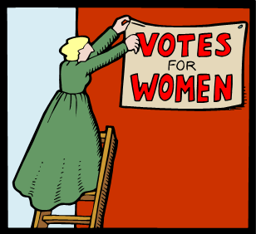

Quick Discussion
In the year 1900, how do imagine people might have argued that women should not vote? What reasoning do you think they might have used?

Slide 8
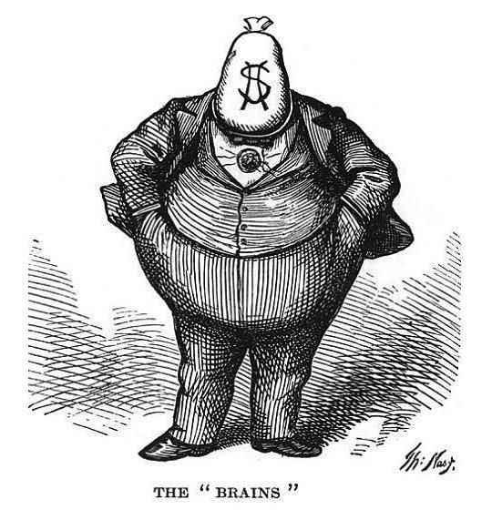
S2: Political and Economic Challenges
Corruption Plagues National Politics
  Many government officials accepted bribes.
  Under the spoils system, politicians gave government jobs to loyal party workers, even if they weren’t well qualified.

Slide 9

Quick Discussion
What should be the qualifications for someone to hold a government job?

Slide 10

Economic Issues Challenge the Nation
Americans Debate the Tariff (tax on imported goods) Question
  Republicans: want a high tariff because it should allow American industries to grow and promote manufacturing jobs.
  Democrats: argued that high tariffs would increase the cost of goods to consumers and make it harder for American farmers to sell their goods overseas.

Slide 11
S3: Farmers and Populism
Farmers Face Many Problems
  In the West and South, farmers received low prices for their crops, but had to pay high costs for transportation.
  Farmers faced increasing debt and decreasing political influence.

Slide 12
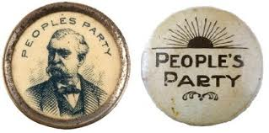
Farmers Organize and Seek Change
The Rise of Farmers Alliances
  Farmers unite to sell their crops together and call on the govt. to help gain low-interest loans
The spread of the Farmers’ Alliances results in the formation of the Populist Party, or People’s Party, in 1892.

Slide 13

The Populist Party
Goals of the Populist Party
  Reform political corruption and unresponsive government
  Fight low prices and high costs for farmers
Limited Success then Decline
  Gained a few political seats in 1894, but by early 1900s it was no longer a real political threat.
Legacy
  Though the Populist Party didn’t survive, many of its ideas became laws and the party got politicians to listen to the common people.

Slide 14
Quick Review of Ch. 12
Why is the period from 1877 – 1900 referred to as the Gilded Age?
In what ways were minority groups discriminated against during this time?
Why did farmers begin to unite? Results of this?

