Slide 1
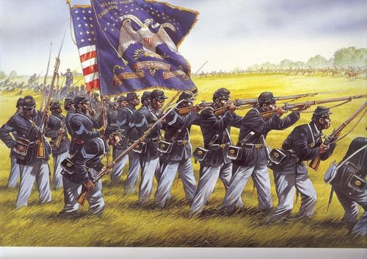
Unit 4
African-Americans During the Civil War and Reconstruction Era
The question of slavery is finally settled during the Civil War. In the following years African-Americans will pursue greater equality as free American citizens.

Slide 2

Quick Review of Ch. 11
African Americans and the Civil War
What were the real reasons for the Civil War?
How did the Emancipation Proclamation change the war?
How were African Americans involved in the Civil War?

Slide 3
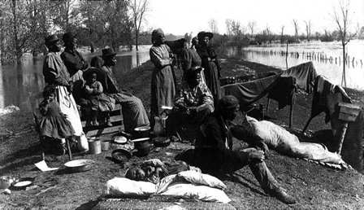
Ch 12: The Promise of Reconstruction
(1865 – 1868)
With the Civil War over and the North victorious, the US government sought to rebuild the country while African-Americans hoped for better days ahead as slavery is a thing of the past.
The Reconstruction Era (1865 – 1877) was the government’s attempt to restore the nation, rebuild the South’s economy, and determine rights for newly freed African-Americans.

Slide 4
Quick Discussion
Imagine you are a newly freed African-American living in the South after the Civil War. What would be your main plans now that you are free?

Slide 5
Section 1: The End of Slavery
Former slaves no longer have to pretend to be loyal to their masters.
What do freed blacks seek now?
  Establish their independence
  Reunite with family members
  Own their own land
The ratification (approval) of the 13th Amendment in 1865 officially abolished slavery throughout the United States for good.

Slide 6
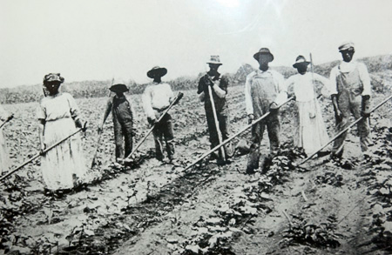
Section 1: The End of Slavery
Immediately after the war, the federal government seemed ready to help former slaves achieve their goal of independence…
But over time, the majority of southern blacks were forced into a system of sharecropping
  Sharecropping: black farmers received a portion of the crops as they worked on someone else’s land

Slide 7
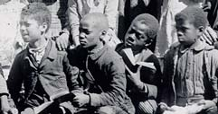
Section 2: Life After Slavery
In the decades after the Civil War, African Americans sought to build free communities
  Again, the black church played a central role in this effort.
  Also, blacks continued to seek educational opportunities, as they recognized the connection between freedom and education.

Slide 8

Quick Discussion
Why do you think freedom and education are so closely intertwined?

Slide 9
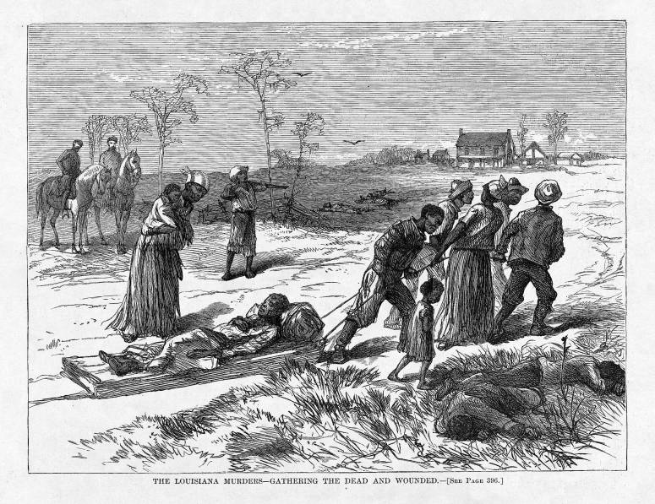
Section 2: Life After Slavery
Unfortunately, many whites in the South took out the frustrations of defeat by attacking black people.
  Little was done to stop the violence and the southern justice system didn’t convict whites accused of attacking blacks.

Slide 10
Section 3: The Crusade for Political and Civil Rights
Under President Andrew Johnson (Lincoln’s Vice President), the Reconstruction Effort in the South came to mean returning things to the way they had been.
  Johnson’s policies favored southern elites and helped return them to power

Slide 11
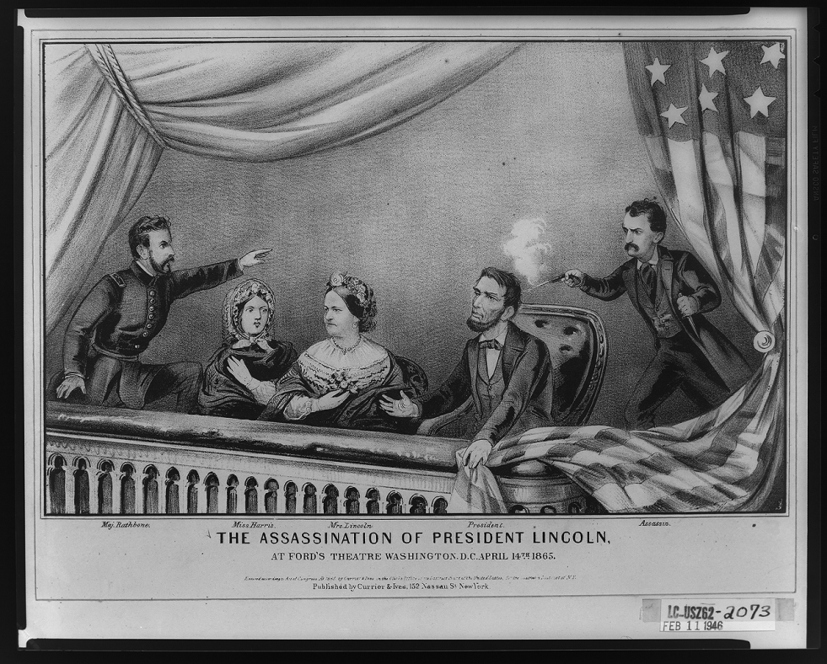
Discussion Question
Sadly, in the final days of the Civil War President Lincoln was assassinated by a radical southerner, John Wilkes Booth.
How do you think Reconstruction after the war might have been different had Lincoln survived?

Slide 12
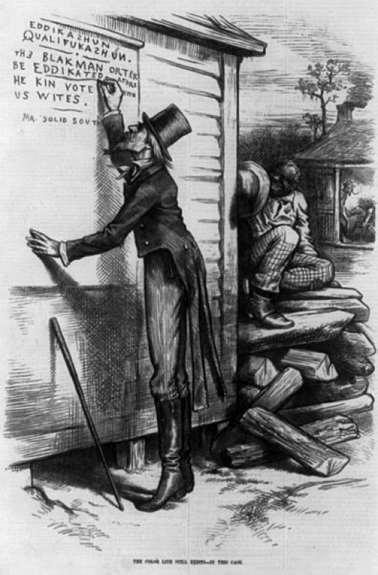
Section 3: The Crusade for Political and Civil Rights
Southern lawmakers began passing black codes, laws that restricted the freedom of blacks.
Examples of black codes
  Blacks couldn’t use alcohol
  Blacks couldn’t own guns
  Blacks couldn’t vote
  Blacks couldn’t serve on juries
Blacks responded to black codes by calling for full civil rights.

Slide 13

Quick Discussion
Why do you think southern lawmakers quickly began to pass laws restricting the freedoms of African-Americans?

Slide 14
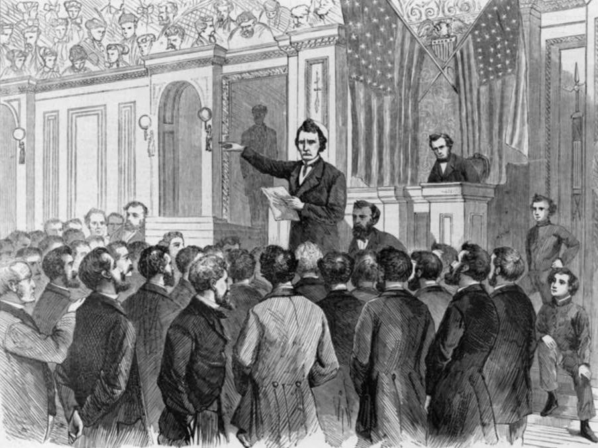
Section 4: The Radical Republicans
Radical Republicans…
  Opposed President Johnson and his policies for Reconstruction
  Supported African Americans having greater equality and becoming full participants in American society.
  They also tended to want
  sterner punishment for
  southerners for seceding
  rather than see a quick
  reconciliation

Slide 15
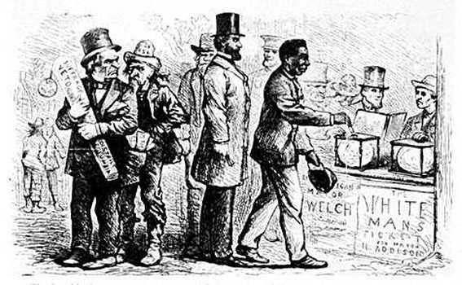
Section 4: The Radical Republicans
Republicans pass the 14th amendment, which extended the right to vote to all adult males (including blacks)
  White southerners opposed radical Reconstruction, as they couldn’t accept a system based on the idea of racial equality.

Slide 16
Quick Review of Ch. 12
The Promise of Reconstruction
How would you describe life for newly freed slaves in the years right after the Civil War?
How did white southerners respond to newly freed blacks living in the South?
Can you compare President Johnson’s approach to Reconstruction with the Radical Republican’s approach?

