Slide 1
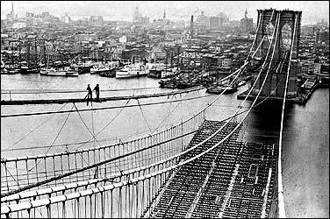
Unit 4: Industrialization of the United States (1865 – 1914)
During the late 19th and early 20th century the US continues to build industry while it also continues its expansion westward.
The building of the Brooklyn Bridge. (Completed in 1883)

Slide 2

Quick Review: Ch. 9 - 10
In what ways did business in the US develop during the late 1800’s and early 1900’s?
Why did so many immigrants come to the US during this time and what impact did they have?

Slide 3
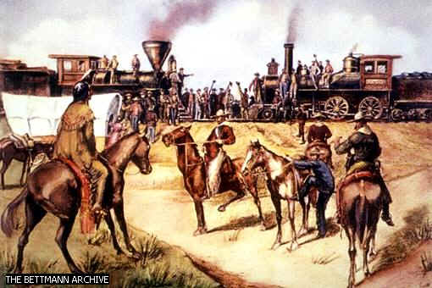
Ch. 11: The South and West Transformed (1865-1900)
The South faces economic hardships and segregation, while continued expansion changes life in the West, especially for Native Americans.

Slide 4

S1: The New South
After Reconstruction, the South attempted to develop its industry, but struggled due to a lack of labor and capital ($ to invest).
The Result: The South remained mostly agricultural and poor.

Slide 5

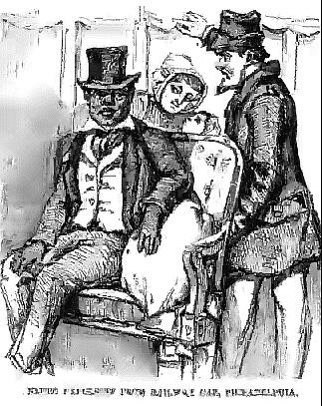
Hard Times in the South
Farmers
  The Bool Weevil Beetle destroys Cotton Crops
  Farmers band together to fight rising costs of shipping by train
African-Americans
  Despite gaining citizenship and access to education, blacks face setbacks as whites push for local and state laws that limit rights for blacks.
    Segregation laws discriminate against blacks
    Groups such as the Kl Klux Klan (KKK) seek
    to terrorize African Americans

Slide 6

Quick Discussion
Why do you think many whites in the South supported segregation laws?

Slide 7
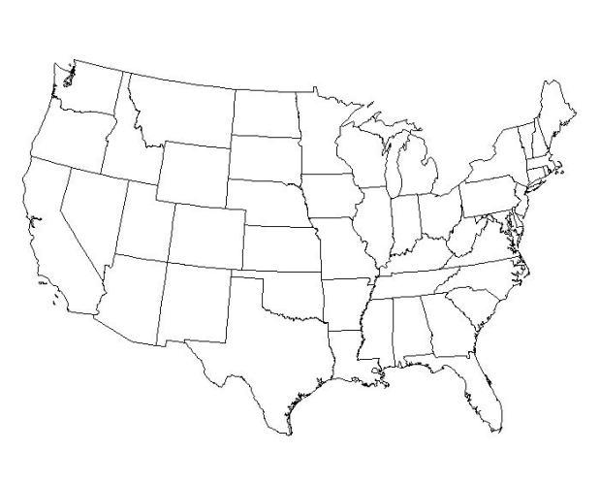

S2: Westward Expansion and the American Indians
During the 1830’s the federal government forced Native Americans to relocate west of the Mississippi River and promised them that land.
However, by the late 1860’s, white settlers are expanding westward and once again coming into conflict with Native Americans.

Slide 8
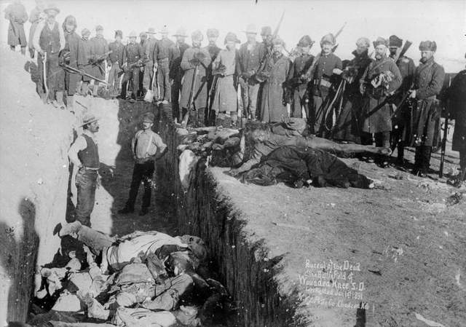
The End of the Indian Wars
Native Americans become angry after being forced to isolated and impoverished areas.
Frustration turns to violent rebellion.
The US government overwhelms Native American warriors, putting an end to resistance for good.
US Calvary killed over 100 Native American men, women and children at Wounded Knee, South Dakota, in 1890. This marked the end of most Native American resistance to white expansion.

Slide 9
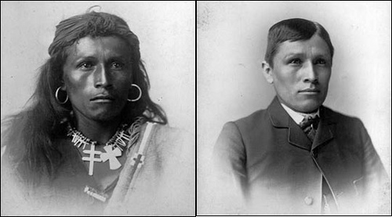
The Government Promotes Assimilation
In an attempt to solve the issue of the Native Americans, the government made efforts to encourage Indians to become farmers and adopt the culture of whites (assimilation).
  Ex: Missionaries and other reformers establish schools for Native American children
Before After

Slide 10

Quick Discussion
Do you think assimilation was a good thing for the Native Americans? Why?
Was the U.S. government right or wrong to promote assimilation?

Slide 11
S3: Transforming the West
Huge changes come to the West following the Civil War.
The transcontinental railroad, linking the East and the West, opens the door for miners, ranchers, and settlers to inhabit western land.

Slide 12


Transforming the West
Miners Hope to Strike it Rich
  Gold and Silver Mining Attracts Big Business
Ranchers Build the Cattle Kingdom
  Large Amounts of Land Available to Raise Cattle
  Railroad makes it possible to ship meat to the East
Farmers Settle on Homesteads
  Despite blizzards and droughts, white settlers attempted to establish farming in the Great Plains of the mid-west.

Slide 13
Quick Review of Ch. 11
How would you describe life in the South following the Reconstruction Era? Why?
How did the US government respond to the ‘problem’ of Native Americans in the West?
What kind of changes are taking place in the West in the late 1800s?

