Slide 1
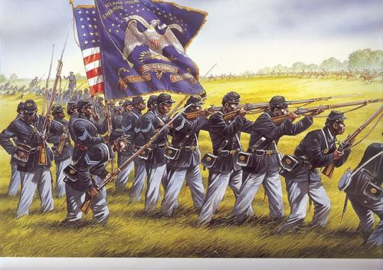
Unit 4
African-Americans During the Civil War and Reconstruction Era
The question of slavery is finally settled during the Civil War. In the following years African-Americans will pursue greater equality as free American citizens.

Slide 2
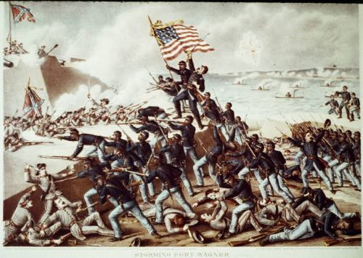
Ch 11: African Americans and the Civil War
1861 - 1865
At the start of the war, the North’s primary goal was to bring the South back and restore the Union. However, along the way, putting an end to slavery became a key focus of the war, changing the fate of the nation and the lives of African-Americans forever.

Slide 3
Section 1: The Civil War Begins
When the Civil War began in 1861, President Lincoln’s main goal was not to end slavery, but rather to preserve the Union.
  In fact, at the start of war, blacks volunteered to fight on the side of the Union (North), but their offers were rejected.
Union = The North
Confederacy = The South

Slide 4
Quick Discussion
When the Civil War began, Lincoln and the North’s leaders were trying to fight a war against the South without really fighting a war against slavery. Why do you think that was?

Slide 5
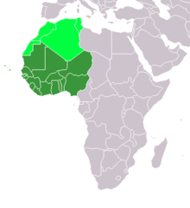
Section 2: Lincoln and Emancipation
Lincoln began the Civil War in support of…
  Compensated Emancipation: paying slave owners for the freedom of their slaves
  Colonization: sending freed blacks back to a colony in West Africa

Slide 6
Section 2: Lincoln and Emancipation
However, as the Civil War dragged on, Lincoln began to consider the abolition of slavery as a tactic for achieving military victory.

Slide 7

Quick Discussion
How could the abolition of Slavery in Confederate (Southern) states be an advantage for Union (Northern) forces?

Slide 8
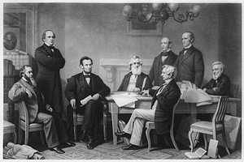
Section 3: Liberation
On September 22, 1862 Lincoln issued the Emancipation Proclamation, declaring that slaves living in states in rebellion on January 1, 1863, would be freed.
  While this of course angered Southern States, it successfully undermined the South and contributed to Union victory, just as Lincoln had hoped.

Slide 9
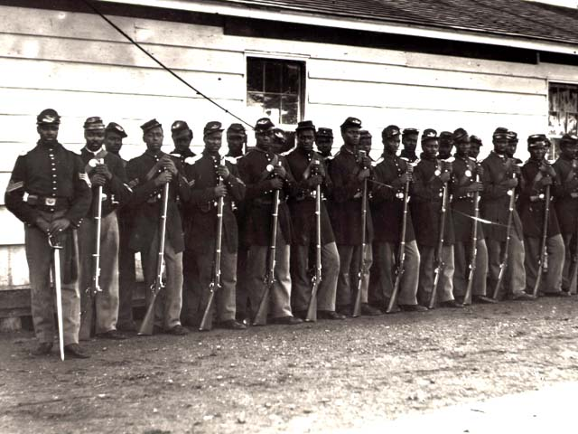
Section 4: Black Men Fight for the Union
The Emancipation Proclamation cleared the way for the enlistment of black troops in the Union army.
  However, the actual recruitment and deployment of black troops did not proceed smoothly, as many whites still believed blacks would not make good soldiers.

Slide 10
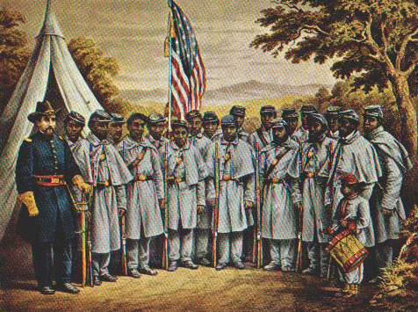
Section 4: Black Men Fight for the Union
Following the Emancipation Proclamation, the most famous black unit to fight for the Union formed, the 54th Massachusetts Regiment.
The 54th Massachusetts Regiment, led by Colonel Robert Gould Shaw (white), was the first all-black military unit to fight for the North. Their bravery and sacrifice in battle helped to combat the myth that blacks made poor soldiers.

Slide 11
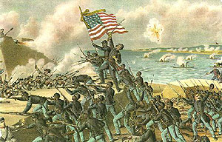
Section 4: Black Men Fight for the Union
*Key Idea*
  Despite discrimination and the belief that blacks would not make good combat soldiers, African Americans participated in every major battle of the war after the Emancipation Proclamation.

Slide 12
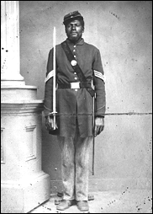
Section 5: The Confederate Reaction to Black Soldiers
Confederate leaders and soldiers did not recognize black men as real soldiers, even going as far as executing captured blacks.
  In response, Union leaders promised to retaliate for the mistreatment of black soldiers.

Slide 13
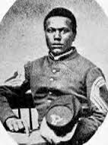
Section 5: The Confederate Reaction to Black Soldiers
Despite the risks, blacks served the Union cause in a variety of ways, acting as…
  Soldiers
  Liberators (of Southern Slaves)
  Spies
  Guides (through Southern Territory)
Slaves took advantage of the war as an opportunity to escape and join the Union.

Slide 14
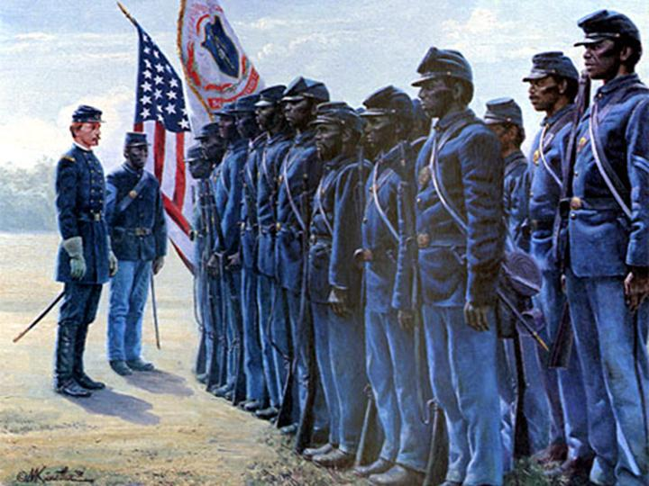
Quick Discussion
Had you been a black male living in the Union during this time, would you have been willing, despite the discrimination and the risk, to volunteer to fight in the war? Why?

Slide 15
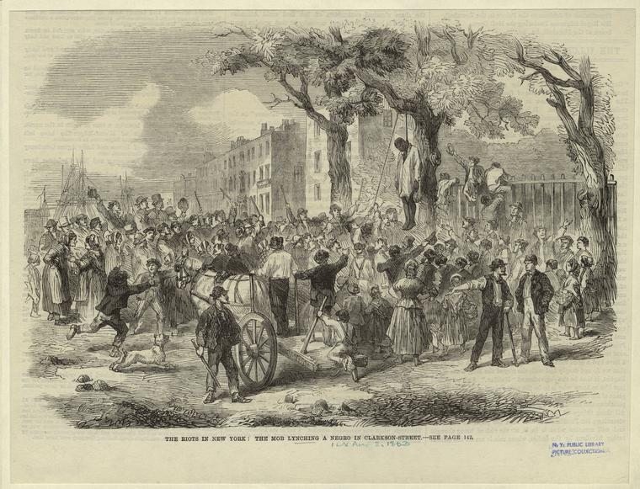
Section 6: Opposition to Black People
Despite their contribution to the war effort, many white Northerners remained resentful and even hostile to African Americans.
During the New York City Draft Riots of 1863, white Northerners attacked and even killed blacks as a way of protesting a war they felt had become about helping black people.

Slide 16
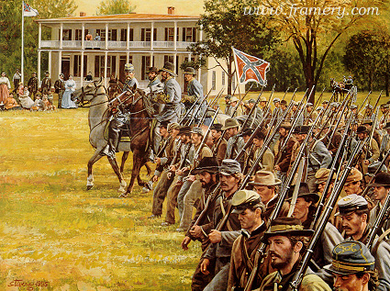
Did you know?
The Confederacy relied on slave labor to help sustain its war effort.
In fact, towards the end of the war, the Confederate Congress actually approved the enlistment of black soldiers to fight for the South, however, by then defeat was inevitable.

Slide 17

Quick Review of Ch. 11
African Americans and the Civil War
Was the Civil War really fought over slavery?
How did the Emancipation Proclamation change the war?
How were African Americans involved in the Civil War?

