Slide 1
Quick Review of Chapter 11
1. How does federalism affect NC?
2. How does an idea become a law in NC?
3. What are some of the Governor’s responsibilities?
4. What is the purpose of the NC courts?

Slide 2

Chapter 12
Local Government in NC

Slide 3
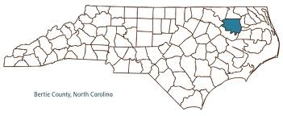
Section 1
Local Govt. in NC
Counties
  100 Counties in NC
  Help States Maintain Law and Order, Collect Taxes, and Provide Services (ex: Healthcare, Public Safety)
Municipalities
  Cities, Towns, or Villages that have state-recognized govts.
  Powers of its govt. are set by the state

Slide 4


Section 2
Local Govt. Services and Revenue

Slide 5

Important Services
Education
  Local School Boards Build Schools and Hire Staff
Healthcare and Welfare
  Local officials carry out programs funded by federal, state, and local govts.
Public Safety
  Local Ambulance, Fire Dept., or Police
Utilities
  Local water, gas, electricity, and garbage collection
Land Use
  Regulate land use now and develop plans for the future

Slide 6
Paying for Services
Taxes
  Property, Income, Sales
Intergovernmental Revenue
  Grants from State or Federal Govt.
Service Charges and Sales
  Ex: Parking in Govt. Parking Lot
  Ex: Local Govt. Sells Property
Borrowing
  Borrow from Banks or Sell Bonds

Slide 7


Section 3
Conflict and Cooperation Between Governments
Key Thought: Local govts. work with other local govts, the state govt., and the federal govt. to accomplish goals. This involves both conflict and cooperation.

Slide 8
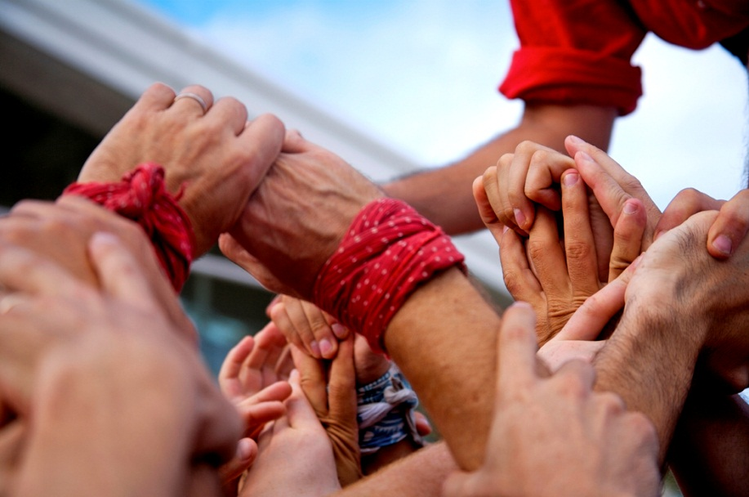
Examples of Conflict
  Competition, Money Disagreements, Authority Challenged
Examples of Cooperation
  Collaboration to provide better services: hospitals, waste management, law enforcement

Slide 9
Quick Review of Ch. 12
What are the main purposes of local governments?
What kinds of services do local governments provide?
How do local governments pay for services they provide?
What’s an example of how different levels of government might have conflict / cooperation?

Slide 10

Ch. 12 Assessment
Page 344
Complete # 1 – 11
  Reviewing Key Terms
    Write out the sentence with correct term underlined.
  Comprehension and Critical Thinking
    Write out the question and your response.
    * Turn in for a grade when completed.

