Slide 1
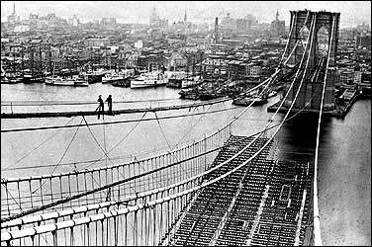
Unit 4: Industrialization of the United States (1865 – 1914)
During the late 19th and early 20th century the US continues to build industry while it also continues its expansion westward.
The building of the Brooklyn Bridge. (Completed in 1883)

Slide 2

Ch. 9 Quick Review
What factors encouraged Industrial Growth in the late 1800s?
What role did the government have during the rise of Big Business? Why?
Why did labor unions begin to develop?

Slide 3

Ch. 10 Immigration and Urbanization
1865- 1914
Industrial Growth in the United States creates job opportunities, prompting many Europeans to move to the cities of the United States in search of a better life.

Slide 4
S1: The New Immigrants
Foreign-born population of the US nearly doubled between 1870 – 1900
  The majority are coming from Europe
Effect: Immigrants adopt parts of American culture, and Americans adopt parts of immigrant culture.
  Nickname for the US = Melting Pot

Slide 5
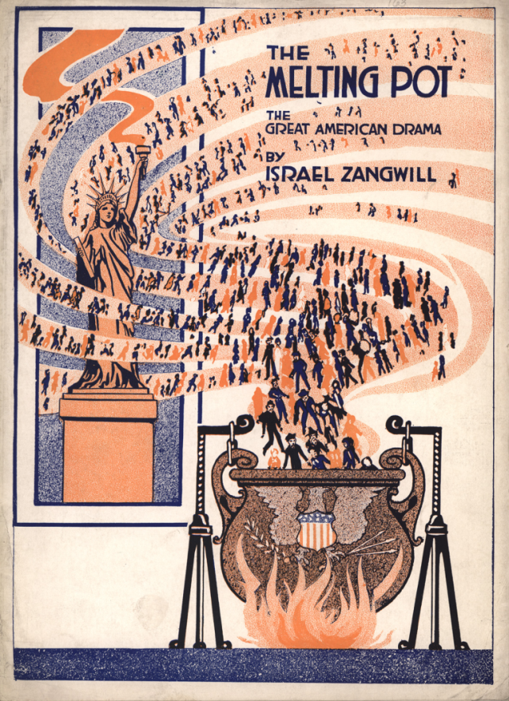
Quick Discussion
In what ways is the United States like a giant Melting Pot? Can you think of examples?

Slide 6
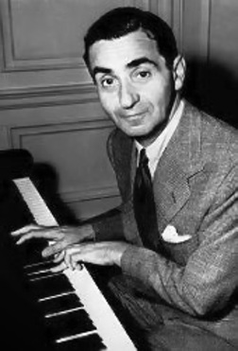
Cultural Contributions
An example of the cultural contributions immigrants brought to America is demonstrated in the life of Irving Berlin.
As a young child he immigrated from Russia to the United States in the late 1800s.
He would grow up to compose many
well-known popular songs such as
“God Bless America” and
“White Christmas”.
Biography.com

Slide 7
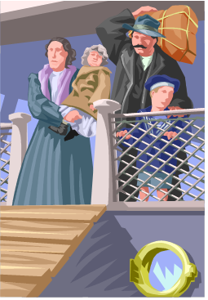
Why did immigrants come to the US?
Push Factors
  Economic Difficulties, Wars and Political Revolutions, and Religious Persecution
Pull Factors
  Available Land and Employment, Economic Opportunity, Religious and Political Freedom
  * Despite opposition from those who looked down on them, immigrants fueled industrial growth, became citizens, and made their traditions a part of American culture.

Slide 8
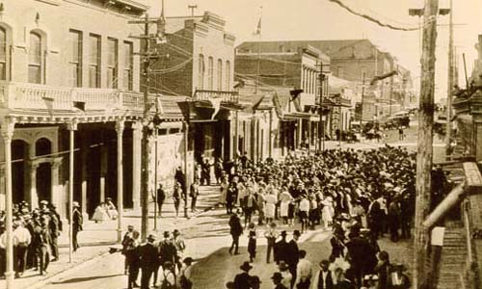
S2: Cities Expand and Change
In the late 19th century, America experienced urbanization.
  Many people left rural areas to live in the city and find employment.
Urban = Related to City Life

Slide 9
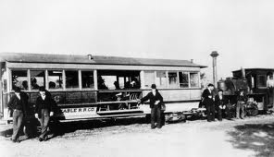
Technology Improves City Life
Examples
  Electric Cable Cars and Subways improve transportation.
  Skyscrapers allow for more office space.

Slide 10
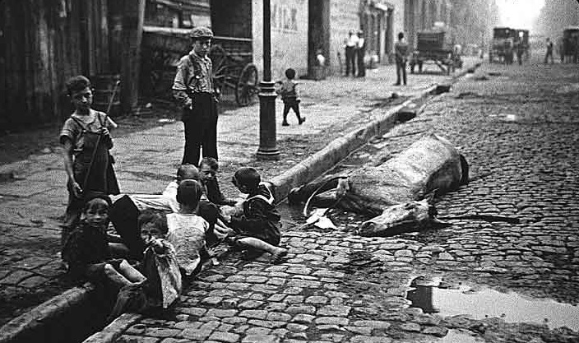
Problems of Urban Living
Overcrowding in Poorer Neighborhoods
Poor Housing Conditions
Dirty Cities = Health Concerns
Greater Risk of Fires and Crime
What’s wrong with this picture??

Slide 11

Quick Discussion
If you had lived during the late 1800s, do you think you would have remained in rural Bertie County, or would you have migrated to a bigger city? Why?

Slide 12
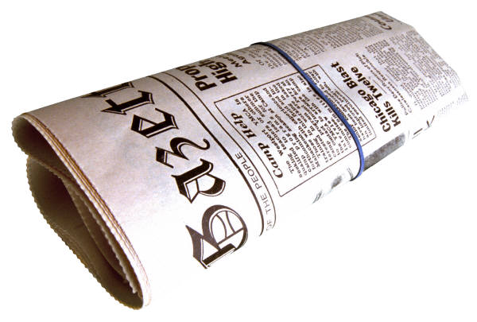
S3: Social and Cultural Trends
The middle-class lifestyle (shopping, sports, popular magazines and newspapers) helped to develop a more commonly shared American culture.
  Mass Culture: Americans across the country are seeking to buy the same things, like shared clothing styles.

Slide 13
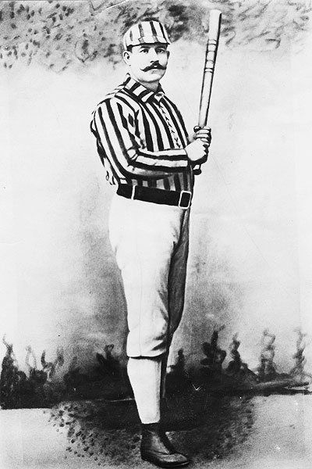
New Forms of Popular Entertainment in the Cities
Amusement Park
  1st Roller Coaster in NY City
Wild West Show Tours America and Europe
Movie Theatres
Spectator Sports
  Baseball, Horse Racing, Bicycle Racing, Boxing, Football

Slide 14

Quick Discussion
Why do you think these new forms of entertainment (movie theatres, amusement parks, baseball) developed after industrial growth caused many to migrate to the cities?

Slide 15

Ch. 10 Immigration and Urbanization Quick Review
What was the motivation for ‘New Immigrants’ to come to the US in the late 19th century?
What is urbanization and why did it take place during this time?
What kind of cultural changes took place in the late 1800s and early 1900s?

