Slide 1
Test on Chapters 8 - 10 Unit 3: Resistance to Slavery Divides the Nation
Review your notes for chapters 8 - 10
Focus on Key Concepts and Terms
About 20 - 30 questions
T/F, MC
2 Essay Questions
Mr. Gay will inform you of the topics.

Slide 2
Essay Question Choose two of the following topics and then write a 1 – 2 paragraph response for each one.
Discuss the ways in which both blacks and whites demonstrated their support for the Abolition movement.
Can you explain the reasons why the Abolition movement struggled to remain totally united?
Can you discuss specific historical events from the 1800s that demonstrate the growing tension in the nation over the issue of slavery?

Slide 3
How will essays be graded?
Essay Grading Criteria
Does your response accurately answer the question?
Did you use examples to support your answer?
Is it 1 – 2 paragraphs and well written?
Is the grammar and spelling mostly correct?
Does the sentence structure fit together to form a well-organized paragraph(s)?

Slide 4
Prepare for your Test
Review your notes
Review your chapter assessments
Review and practice writing out the essay questions and your answer
Make flashcards / a study sheet
Quiz each other
Review todaysmeet.com content

Slide 5
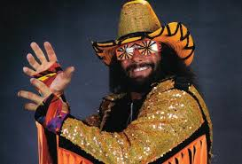
Any questions about your test?

