Slide 1
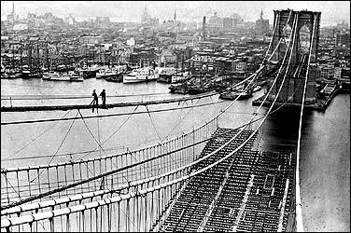
Unit 4: Industrialization of the United States (1865 – 1914)
During the late 19th and early 20th century the US continues to build industry while it also continues its expansion westward.
The building of the Brooklyn Bridge. (Completed in 1883)

Slide 2
Chapter 9: The Triumph of Industry
1865 - 1914
Thanks to funding by business leaders and the work of creative inventors and scientists, the United States becomes an industrial powerhouse.

Slide 3

S1: Technology and Industrial Growth
After the Civil War, many Americans embraced innovation and technology with the goal of expanding business and improving daily life.
Known as the ‘Second Industrial Revolution’
  US becomes an industrial powerhouse

Slide 4
Encouraging Industrial Growth
Factories step up production during and after the Civil War
Railroads Expand (Connecting the Country and Business Markets)
Government encourages immigration to meet the increasing demand for labor

Slide 5
Innovation Drives the Nation
Businessmen invest in the development of new inventions hoping to create new industries and expand old ones.
Examples of Innovation
  The Light Bulb (invented by Thomas Edison)
  The Telephone (invented by Alexander Graham Bell)
  Stronger Steel = Skyscrapers and Suspension Bridges

Slide 6

Quick Discussion
In what ways did the invention of the light bulb revolutionize the way people live?

Slide 7

Industrialization’s Impact
US exports grain, steel, and textiles to international markets
More people head to the cities for work
Industrial waste on the rise
What’s the difference between importing and exporting goods?
Why might it be important for a country to both import and export goods?

Slide 8

S2: The Rise of Big Business
American businessmen invest large amounts of money and resources to make a profit, turning the US into a powerful economic country.

Slide 9
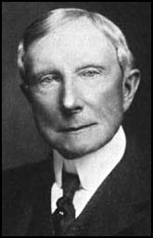
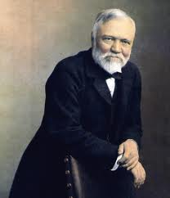
Fighting for Profits
Large Corporations develop and seek ways to gain a competitive edge
  Ex: John D. Rockefeller, an oil tycoon, made deals with railroads to increase his profits.
  Ex: Andrew Carnegie, a steel tycoon, increased his power by controlling the many businesses that made up all the phases of producing steel.

Slide 10

Debating the Role of Big Business
Business Mergers (Corporations) create wealthy business leaders, but smaller companies and consumers begin to question if big business is being fair?

Slide 11

Quick Discussion
Do you think big corporations, such as Walmart, are a good thing or a bad thing? Both? Why?

Slide 12

The Government Imposes Regulations
Interstate Commerce Commission (ICC)
  Govt. monitors railroad operations
Sherman Antitrust Act
  Outlawed trusts (several companies under the control of one board) that restrained trade
*Begins a trend toward federal limitations on corporations power
Should the federal government regulate big businesses? Why?

Slide 13
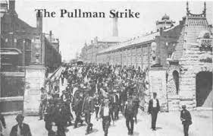
S3: The Organized Labor Movement
America’s booming economy in the late 1800’s relied on workers, however many workers began to protest low pay and unsafe work conditions.
The Pullman Strike was a violent railway workers’ strike which began outside of Chicago and spread nationwide.

Slide 14
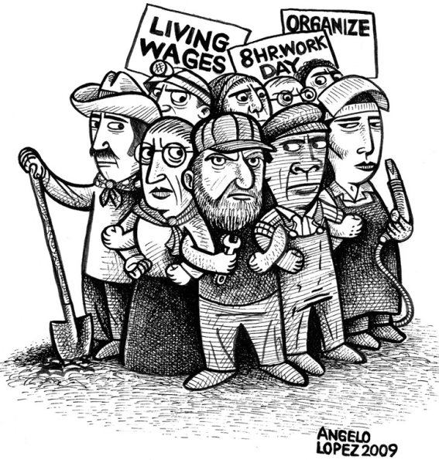
Labor Unions Form
Workers begin to organize as a group in labor unions to negotiate for better pay and working conditions.
Workers can threaten to strike if demands are not met.
An example of a labor union in the late 1800s would be the development of the large group known as The Knights of Labor.

Slide 15
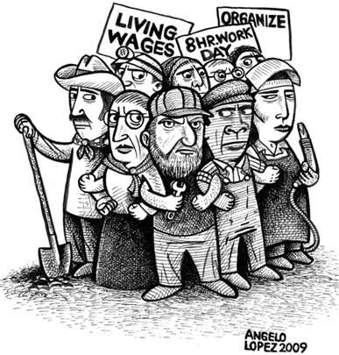
Strikes Rock the Nation
Union strikes become more common in the late 1800’s, sometimes resulting in violence.
The federal government steps in to restore order.
In the future the federal government tends to side with companies over union strikes.

Slide 16

Quick Discussion
Are labor unions a good thing or bad thing? Why?

Slide 17
Quick Review of Ch. 9
The Triumph of Industry
How did industrial growth take place in the US in the years after the Civil War?
What is ‘big business’ and how did the government respond to it?
Why did labor unions develop?
How would you describe economic development in the U.S. from 1865 – 1914?

