Slide 1
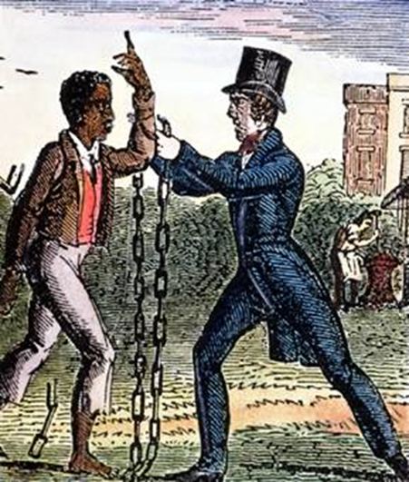
Unit 3
Resistance to Slavery Divides the Nation
Abolitionists, both black and white, fight against the continuance of slavery. This struggle will ultimately disunite the USA.

Slide 2

Quick Review of Ch. 8 - 9
In what ways did both blacks and whites support the abolition movement?
Why did the abolition movement struggle to remain united over time?

Slide 3
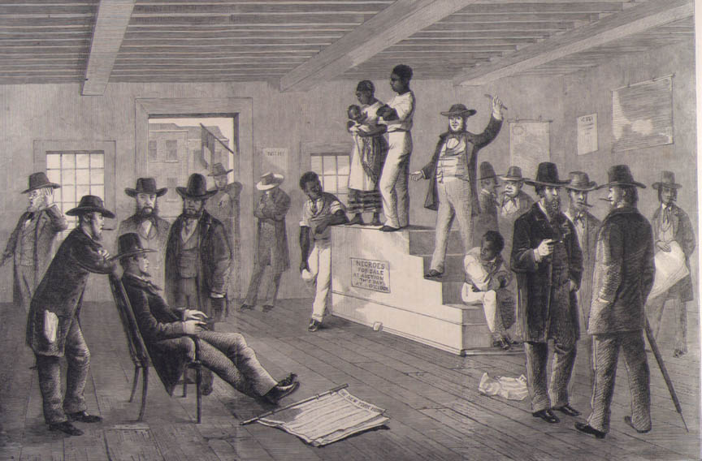
Ch. 10: The United States Disunites over Slavery (1846 – 1861)
By the end of the 1840s, no issue was as controversial as slavery. Debate over the expansion of slavery divided the American people and set the nation on a course that would result in Civil War.

Slide 4
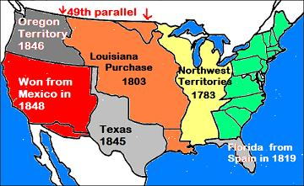
Section 1: The Lure of the West
The United States continued expansion westward led to increased political debate over the expansion slavery.
  Free States = greater Northern influence
  Slave States = greater Southern influence
The Key Question: Would new states be free or slave?

Slide 5
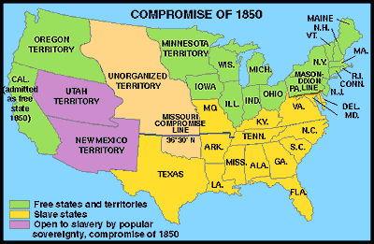
The Compromise of 1850
The federal government attempted to satisfy both Northerners and Southerners.
  California joins as a free state
  Slave trade banned from Washington, DC
  Fugitive Slave Law helps slave owners regain runaway slaves
  New Mexico and Utah can vote for themselves if they want slavery or not (A Concept Called Popular Sovereignty).

Slide 6
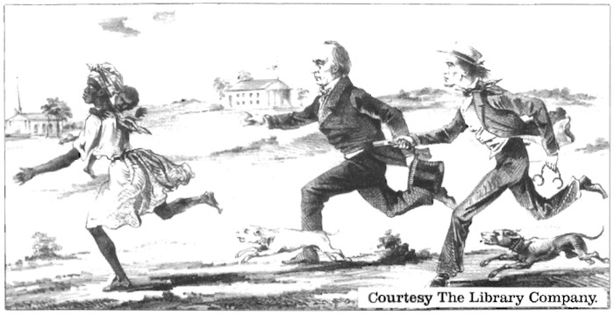
Section 2: Fugitive Slaves
The Fugitive Slave Law of 1850
  Easier to seize suspected runaways
  Compelled legal officials and ordinary citizens to help capture runaway slaves
Antislavery organizations were outraged!! They vowed to oppose the law.

Slide 7
Quick Discussion Question
The federal government attempted to maintain peace with the Compromise of 1850, however, ultimately it failed. Many Northerners were especially angry at the Fugitive Slave Law.
Can you think of any other examples of Americans being divided or angry because of government decisions?

Slide 8
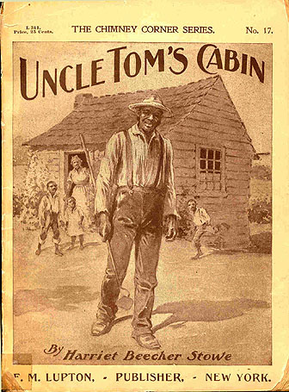
Section 3: The Deepening Crisis Over Slavery
Despite hostility from many whites toward African-Americans in the North
  Anti-slavery feelings continued to grow.
Harriet Beecher Stowe’s novel, Uncle Tom’s Cabin, painted a negative image of slavery in the South and spurred on anti-slavery feelings.

Slide 9
Quick Discussion
What does the term ‘Uncle Tom’ often mean in today’s vocabulary?

Slide 10
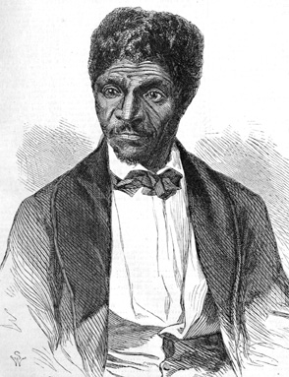
Section 3: The Deepening Crisis Over Slavery
The fight over slavery in Kansas and the Supreme Court’s ‘Dred Scott Decision’ further increased tension and led to violent confrontations.
Dred Scott was a slave whose master had taken him with him to live in the North. When his master died, Scott sought his own freedom. However, in 1857 the Supreme Court ruled that he was still the property of his owner’s family. This solidified that the government viewed slaves as property and also outraged abolitionists!

Slide 11
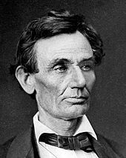
Section 4: Abraham Lincoln and Black People
In 1858, Lincoln ran for Senate in Illinois, with the main issues being slavery and race.
He argued against the expansion of slavery, although he did not argue for racial equality.
He lost the election, but gained a following that would prepare him for his next political challenge…. Running for President!
Pre-Beard Lincoln

Slide 12
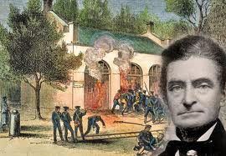
John Brown and His Failed Raid on Harper’s Ferry
John Brown, a white abolitionist, planned to end slavery by force.
He and his forces attempted to raid a weapons storage at Harper’s Ferry, VA, with the goal of giving weapons to slaves so they could revolt.
The raid failed and he and his men were captured and killed.
This event further increased the tensions between proslavery and antislavery forces.

Slide 13
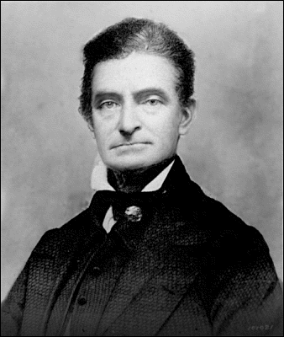
Quick Discussion
John Brown: Martyr or Criminal?

Slide 14
Section 5: The Election of Abraham Lincoln
Lincoln’s election in 1860 was more the result of disunity in his opposition rather than the strength of his own support.
Uncertainty over Lincoln’s views on slavery and race cause many in the North and South to distrust him and fear the worst.

Slide 15
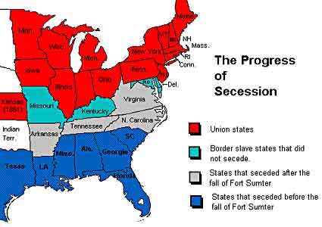
Section 5: The Election of Abraham Lincoln
White southerners feared that Lincoln would seek to not only stop the expansion of slavery, but to also end slavery for good.
These fears (and the fact that Southerners did not vote for Lincoln) led the South to eventually secede (withdraw) from the United States.

Slide 16
Quick Review of Ch. 10
The US Disunites over Slavery
How did the Fugitive Slave Law increase tension for Northerners?
What is the significance of the Dred Scott Decision?
Why was Abraham Lincoln’s election as President the ‘final straw’ for the growing tension in the United States?

