Slide 1
Quick Review: Ch. 8 - 9
1. What are the responsibilities of members of Congress?
2. How does a proposed bill become a law?
3. What are some of the president’s job descriptions?
4. What do executive departments do?
5. How does the U.S. federal govt. attempt to prevent the abuse of power?

Slide 2
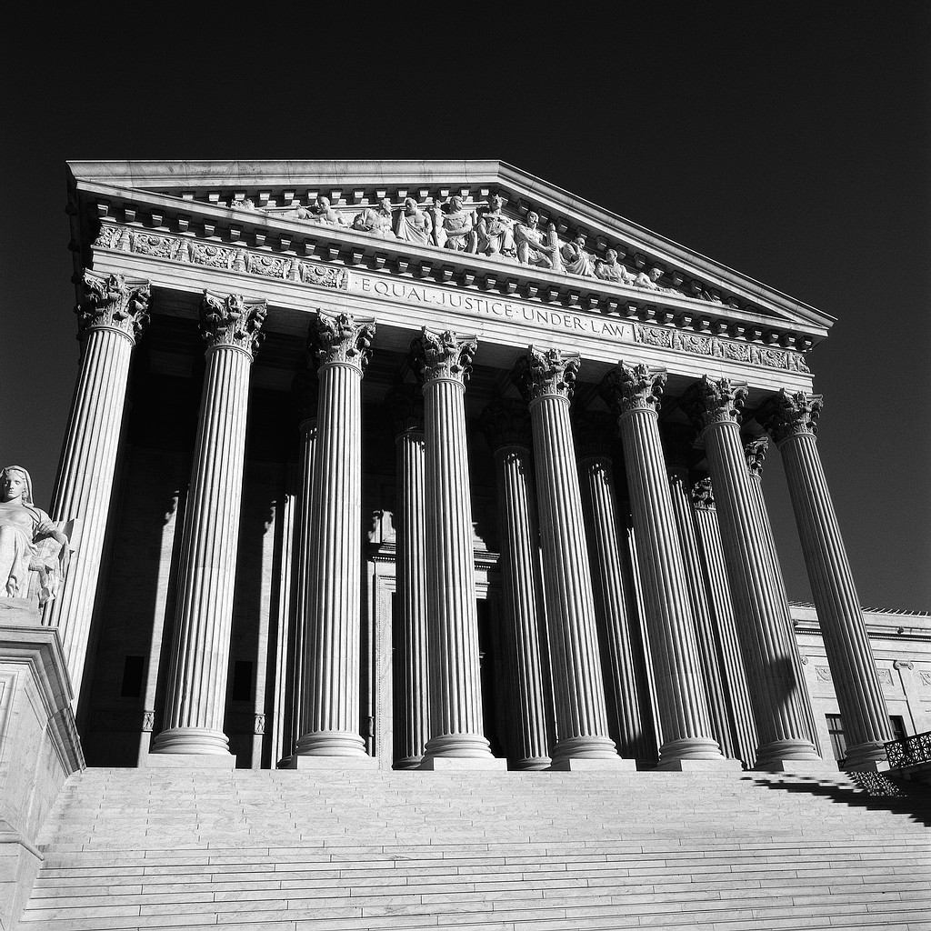
Ch. 10: The Judicial Branch

Slide 3
*Key Concept*
The Judicial Branch, led by the Supreme Court, helps to protect our rights by judging federal laws and interpreting the Constitution.

Slide 4
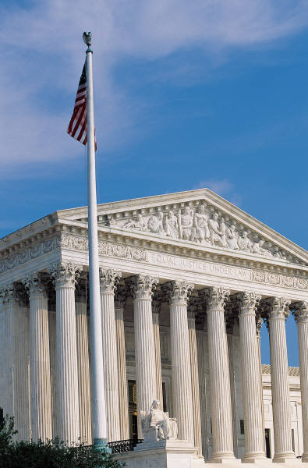
Section 1: The Role of the Federal Courts
Our Legal System
  A framework for resolving conflicts and protecting citizen’s rights
Judicial Branch
  The Supreme Court and 100+ Federal Courts

Slide 5
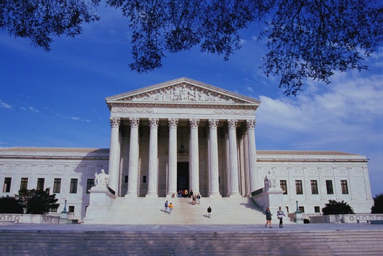
Federal Courts hear 2 kinds of cases.
1. Cases on federal laws and issues beyond the authority of individual states.
  Ex: Not Paying Federal Taxes
2. Cases appealed (ask to reconsider a decision) from state supreme courts.
  Involve federal law or constitutional issues. Sent to the Supreme Court.
  Ex: 1973: Supreme Court said abortion is legal in all states.

Slide 6
Section 2: The Organization of the Federal Courts
The Federal District Courts
  94 courts scattered across the U.S.
  Handle the majority of federal cases
  Each state has at least 1.

Slide 7
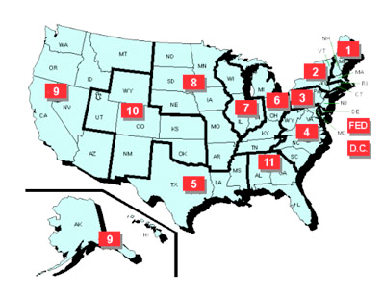
The Court of Appeals
12 U.S. Court of Appeals
Handle Appeals from a geographic group of the federal district courts (p. 273 map)
Determine whether the original trial was fair

Slide 8
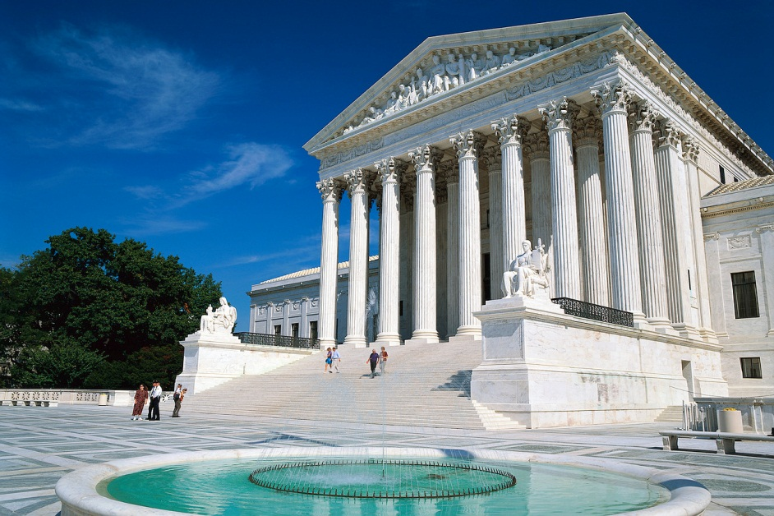
The Supreme Court
The Highest Federal Court.
Purpose: The final court of appeals for state and federal court systems.

Slide 9
Federal Court Judges
Chosen by the President and confirmed by the Senate.
Do the work of the Judicial Branch.
Can’t favor political parties.
Settle individual cases, helping to define and clarify laws made by legislators.
Great Responsibility
  Balance individual’s rights with what’s best for the nation.

Slide 10
Section 3: The Supreme Court
Highest Court in the U.S.
Final say on what the Constitution means
Judicial Review: power to overturn any law the Court decides is Unconstitutional.

Slide 11
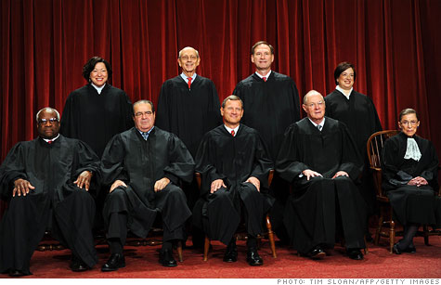
The Work of the Supreme Court
Choose Cases to Hear (About 100 a year)
Hear the Arguments
Make a Decision (9 Justices Vote)
Write the Reasons for their Decision

Slide 12
What can we say about the 9 Supreme Court Justices based on this picture?

Slide 13
Quick Review
What is the purpose of the Judicial Branch?
What kind of courts make up the Judicial Branch?
What do you know about Federal Court Judges?
How does the Supreme Court work?

Slide 14

Ch. 10 Assessment
Page 288
Complete # 1 – 13
  Reviewing Key Terms
    Write out the sentence with correct term underlined.
  Comprehension and Critical Thinking; Activities
    Write out the questions and your response.
    * Turn in for a grade when completed.

