Slide 1
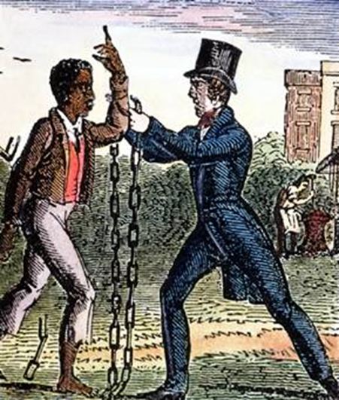
Unit 3
Resistance to Slavery Divides the Nation
Abolitionists, both black and white, fight against the continuance of slavery. This struggle will ultimately disunite the USA.

Slide 2

Quick Review of Ch. 8
Opposition to Slavery
How did the issue of slavery effect political parties?
How could you argue that the Abolition Movement was really two movements?
How did black women join in the fight against slavery?

Slide 3
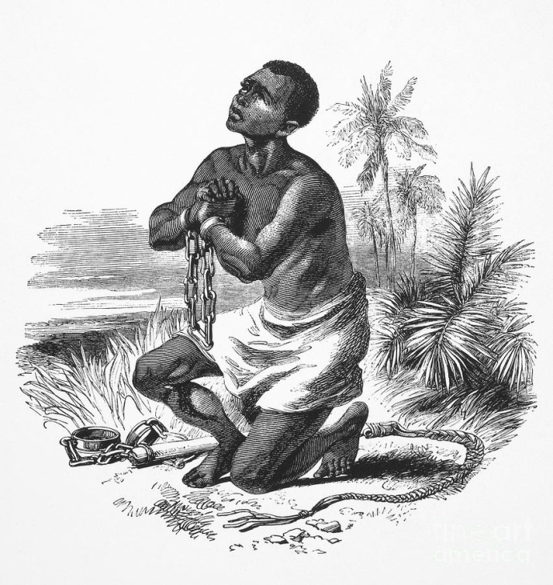
Chapter 9: Let Your Motto be Resistance (1833 – 1850)
In response to changes in American culture, unrest among slaves, and conflict between the North and South, the biracial northern antislavery movement became more divided but also more powerful.

Slide 4
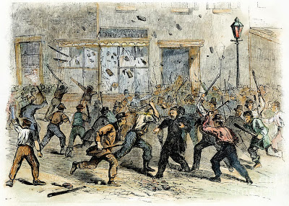
Section 1: A Rising Tide of Racism and Violence
Cause = The Abolition movement gained momentum
Effect = Anti-black riots increased
Philadelphia experienced the worst race riots of this period.
Anti-black Riot in Philadelphia, 1842

Slide 5
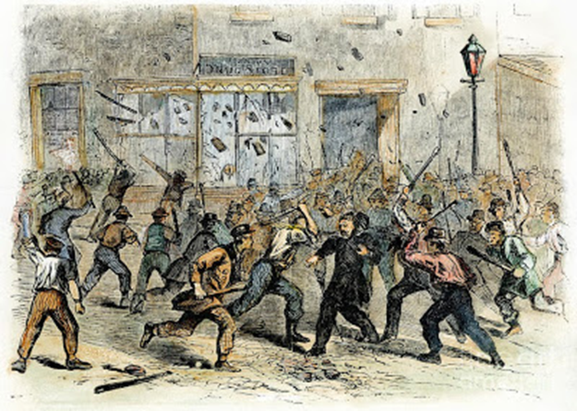
Quick Discussion
Why do you think anti-black riots in the North increased along side the growth of the abolition movement?

Slide 6
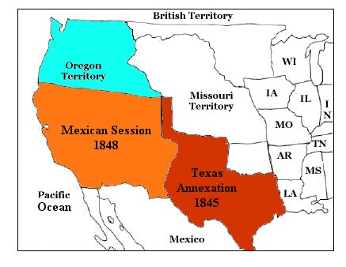
Northern Concerns
Under President James K. Polk, the US expanded it’s territory westward (Texas), creating more territory for slavery to expand.
  This raised fear in the North of political domination by the slaveholding South.

Slide 7
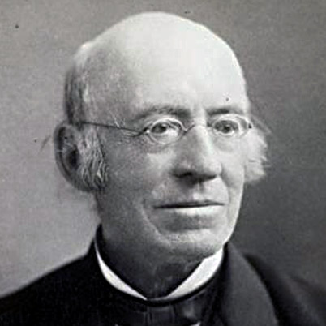
Section 2: The Response of the Antislavery Movement
William Lloyd Garrison establishes the American Anti-Slavery Society (AASS) in 1833.
  Dedicated to emancipation and equal rights for African-Americans. (Not Violent but Uncompromising)
  Becomes the most important abolitionist organization of its time.
William Lloyd Garrison

Slide 8
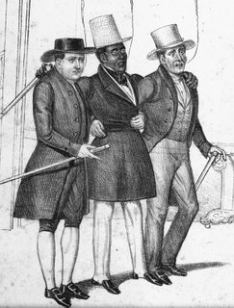
Section 2: The Response of the Antislavery Movement
Black men, black women, and white female abolitionists formed organizations to work alongside the AASS.
Also, local, state and national black conventions created opportunities for black abolitionists to speak out.

Slide 9
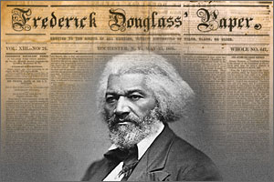
Section 3: Black Community Institutions
Free Black Communities contributed to the spread of the abolition movement
  Black Churches played a key role in the anti-slavery movement.
    The majority of black abolitionist leaders were ministers.
  Black Newspapers were an important voice for Abolition
    Examples: Frederick Douglass’s North Star

Slide 10

Discussion Question
Why do you think the majority of abolitionist leaders were also ministers?

Slide 11
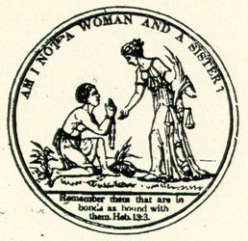
Section 4: The Changing Abolitionist Movement
In the 1830s…
  The AASS pursued a strategy based on moral grounds, challenging Americans to listen to their Christian conscience.
In the 1840s…
  The AASS split up in the face of limited success, slave unrest, and disagreement over the role of women in the AASS.

Slide 12
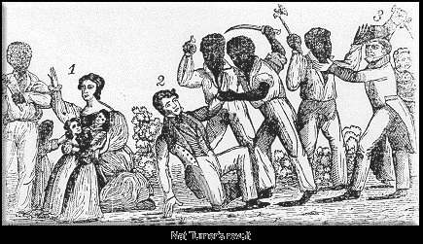
Section 4: The Changing Abolitionist Movement
New Abolition organizations formed.
  Ex: The Liberty Party: 1st antislavery political party
Slave Revolts encouraged militancy among northern abolitionists.
Perhaps the most famous slave revolt was led in 1831 by Nat Turner in Virginia.

Slide 13
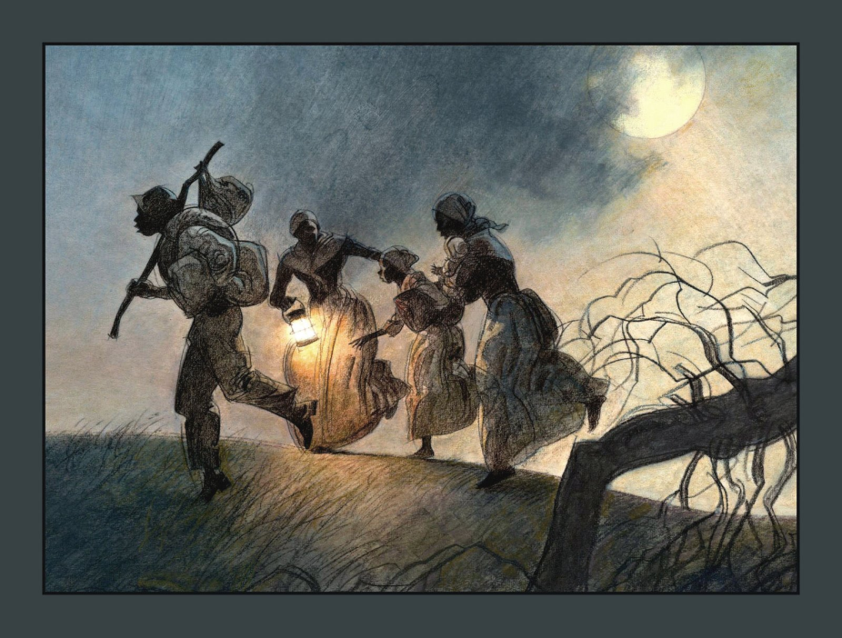
Section 4: The Changing Abolitionist Movement
Runaway slaves from the South traveled the ‘Underground Railroad’ to escape slavery.
  Networks of free blacks and some whites who provided help to the fugitives in their escape.
  Many hoped to make it all the way to Canada.
Discussion Q: Why do you think it became known as the ‘Underground Railroad’? Why not the ‘secret pathway’ or ‘road to freedom’, etc.?

Slide 14
Section 5: Resistance and Nationalism
3 Key Concepts
  During the 1840s more and more black abolitionists became willing to consider force to end slavery.
  Gradually Black and White Abolitionists Grew Apart
  Black leaders debated Integration vs. Nationalism
    Should blacks integrate with whites or seek to form their own nation?
What do you think would have been the positives and negatives of Integration? What about Nationalism?

Slide 15
Quick Review
Why did American expansion westward raise concern for Northern politicians?
How did free black communities support the anti-slavery movement?
What are some reasons why the abolition movement struggled to remain united?

