Slide 1
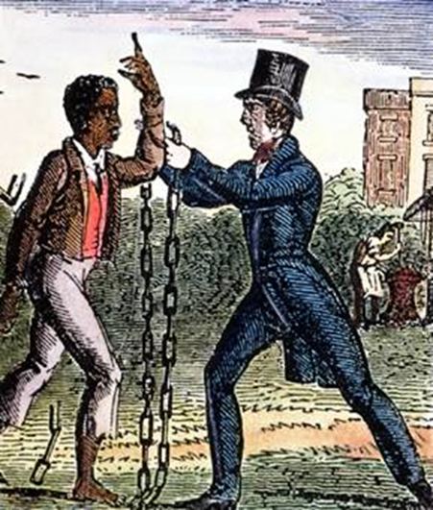
Unit 3
Resistance to Slavery Divides the Nation
Abolitionists, both black and white, fight against the continuance of slavery. This struggle will ultimately disunite the USA.

Slide 2
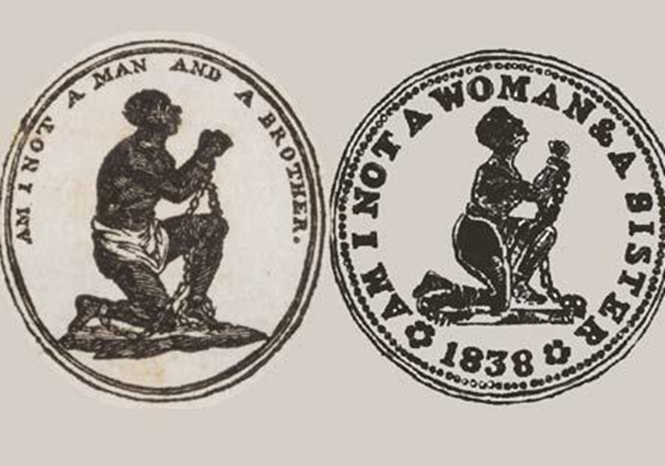
Chapter 8: Opposition to Slavery
1800 - 1833
The early 19th century witnessed the beginnings of a committed antislavery movement in the United States.

Slide 3

Section 1: A Country in Turmoil
Political Parties React to Slavery
  Democratic Party
    Represented the interests of the South’s slaveholding white male elite.
    Favored states’ rights that protected slavery from interference by the national government.
    Supported the expansion of slavery into new territory.
  Whig Party
    Did not directly seek to end slavery. However, in the North, the party’s focus on Christian morality and opposition to territorial expansion attracted opponents of slavery.
    Some northern Whig politicians defended the human rights of African Americans (as well as American Indians).
    Black men, who could vote, voted for Whig candidates.

Slide 4
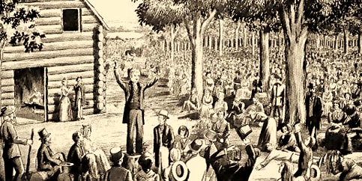
Revival -> Reform
A Religious Revival, known as the 2nd Great Awakening, gripped the nation from the late 18th century into the 1830s.
  This spurred reform movements to improve American society, including….
    The Antislavery (Abolition) Movement
Discussion Q: How do you think religion could be used to support continuing slavery or to support ending slavery?

Slide 5
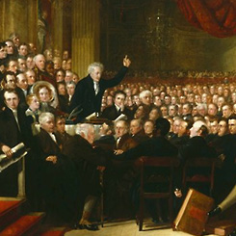
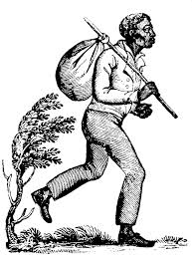
Section 2: Abolitionism Begins in America
The Antislavery Movement was really two movements…
  Antislavery in the North
    Consisted of outspoken black and white abolitionists
    The Quakers, a religious group, played a key role in starting abolition organizations
  Antislavery in the South
    Consisted of slaves with the help of free blacks and a few sympathetic whites
    Helped spread the antislavery movement but had to operate more in secret

Slide 6
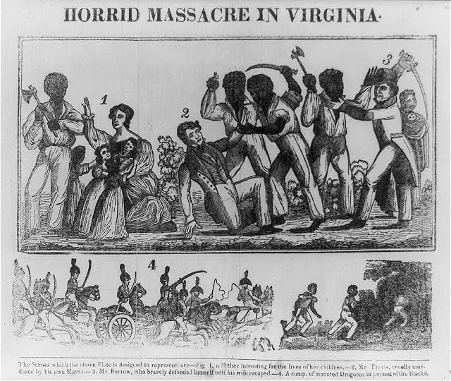
Section 2: Abolitionism Begins in America
Radical Attempts to Abolish Slaveries
  Efforts to launch slave revolts in the South caused many proslavery whites to further their commitment to continuing slavery.
19th century depiction of a slave revolt led by Nat Turner in Virginia in 1831.

Slide 7

Discussion Question
Do you think the slave revolts were justified? In other words, did slaves have the right to use violence and possibly kill in order to overthrow their masters? How could you argue they did or didn’t have the right to kill their owners?

Slide 8
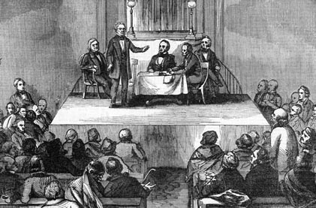
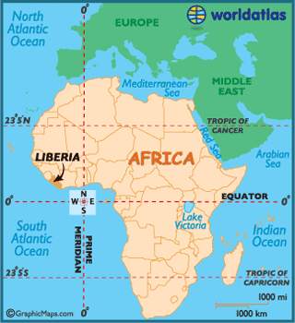
Section 3: Colonization
The American Colonization Society (ACS)
  Most significant white antislavery organization of the 1810s and 1820s
  Two Major Goals
    1. Abolish slavery gradually in the United States.
    2. Send emancipated free blacks to Liberia, Africa.

Slide 9
Section 3: Colonization
Opinion among African Americans was split over the issue of colonization.
  Some believed blacks would never achieve equal status in the US, so they should return to Africa.
  Others saw themselves as Americans, and had no desire to return to Africa, a land they saw as foreign.

Slide 10
Discussion Question
How do you think free African-Americans decided whether or not to stay in the United States or return to Africa during this time?

Slide 11
Section 4: Black Abolitionists
Black women joined black men in opposition to slavery.
  Those from wealthier families formed anti-slavery societies and focused on educating black children.
  Those from poorer families (the majority) risked everything to help fugitive slaves and also saved their earnings to purchase freedom for themselves or their loved ones.

Slide 12
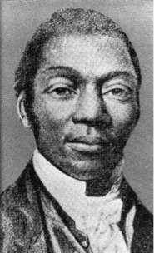
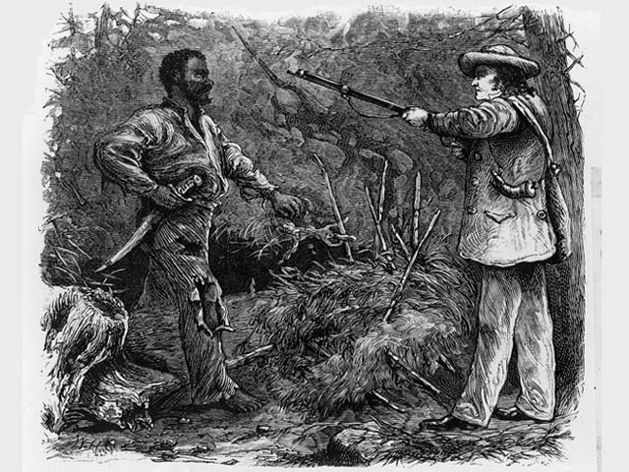
Section 4: Black Abolitionists
David Walker, born free in NC, aggressively attacked slavery and white racism in his writing Appeal.
  His writing style would influence key white abolitionist William Lloyd Garrison.
Nat Turner, a leader among slaves in VA, led a violent slave revolt which left southern whites fearful and again strengthened their position to maintain slavery. He was later captured and killed.
David Walker
Nat Turner

Slide 13

Quick Review of Ch. 8
Opposition to Slavery
How did the issue of slavery effect political parties?
How could you argue that the Abolition Movement was really two movements?
How did black women join in the fight against slavery?

