Slide 1
Quick Review
Ch. 4 - 7
1. Why did the Colonists declare their independence from England?
2. Based on the Constitution, what are the goals of government?
3. How were NC colonists involved in the American Revolution?
4. In what ways does the Bill of Rights provide protection for citizens?
5. Why are amendments so important to the constitution?

Slide 2
Review Game
What’s on the ppt?
Chapters 4 - 7

Slide 3
‘What’s on the ppt?’ Rules
2 Teams are Competing
1 Teammate will have his / her back turned to the ppt
Teammates will have 30 seconds to try to describe what is on the ppt, but YOU CAN’T SAY ANY OF THE WORDS ON THE PPT
If the Teammate can guess what’s on the ppt, your team get’s a point!
Whoever ends with the most points wins!

Slide 4
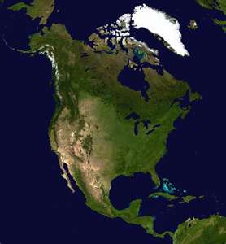
Example
The word is ‘North America’
Teammates can not say ‘North’ or ‘America’
Also, no rhyming or starts with ‘N’

Slide 5
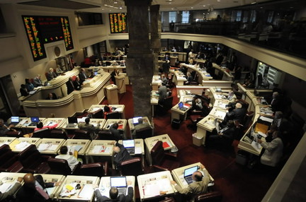
Legislature

Slide 6
Direct Democracy

Slide 7
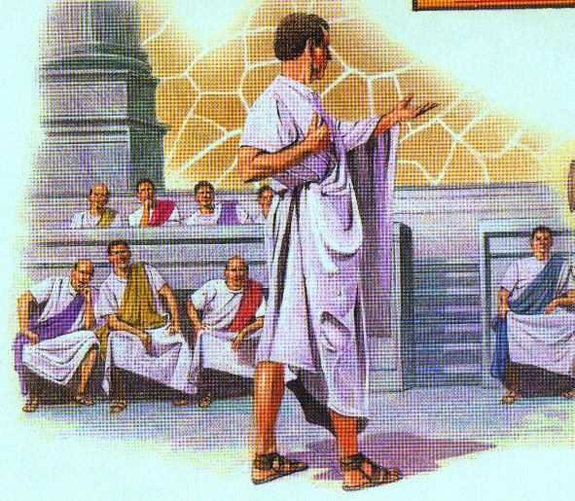
Republic

Slide 8
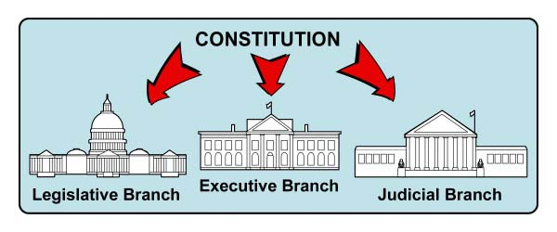
Separation of Powers

Slide 9

Ratification

Slide 10
Compromise

Slide 11
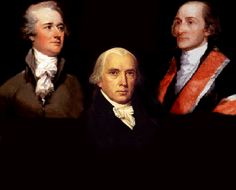
Federalists

Slide 12
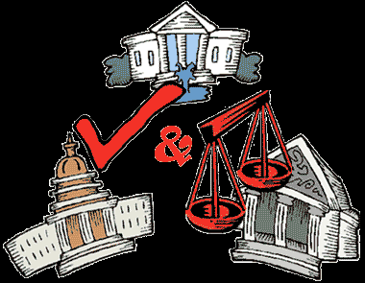
Checks and Balances

Slide 13

Amendments

Slide 14
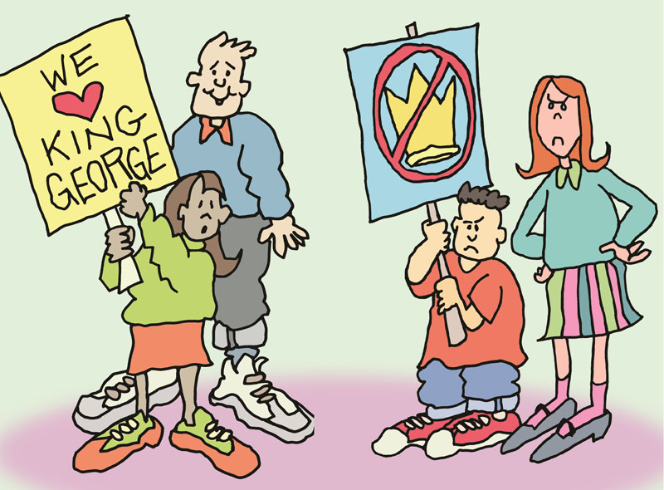
Loyalist

Slide 15
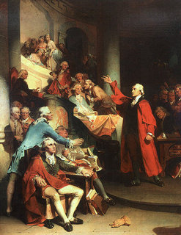
Anti-Federalists

Slide 16

Cash Crop

Slide 17
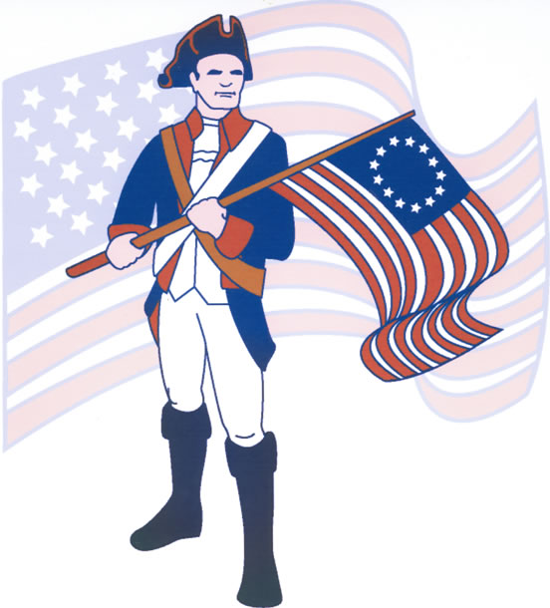
Patriot

Slide 18
Legislators

Slide 19
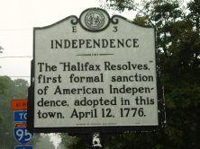
Halifax Resolves

Slide 20
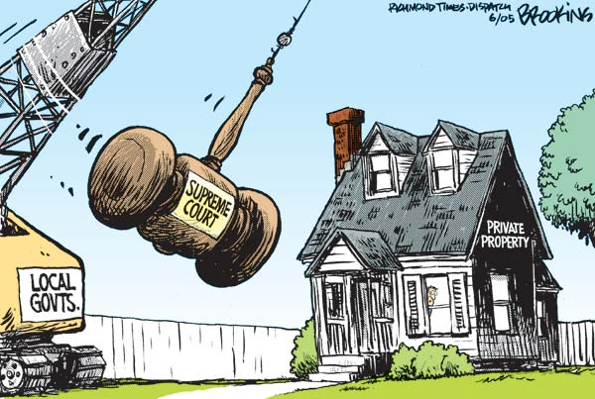
Eminent Domain

Slide 21
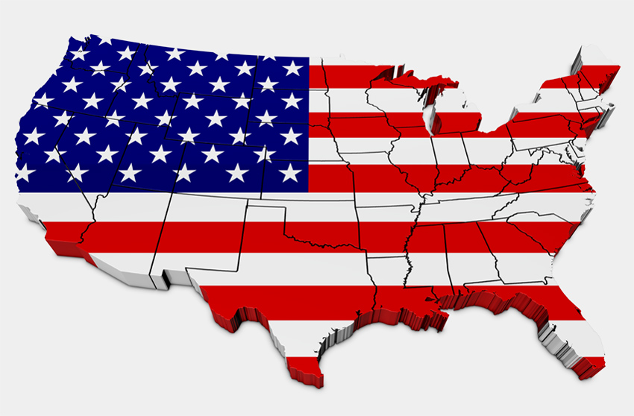
Federalism

Slide 22
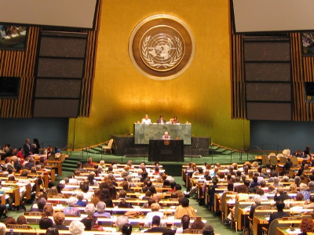
General Assembly

Slide 23
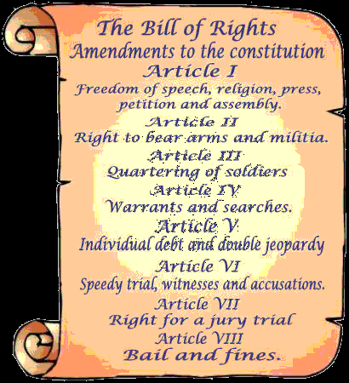
Bill of Rights

Slide 24
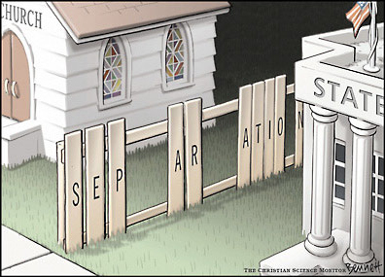
Separation of Church and State

Slide 25


Double Jeopardy

Slide 26

Freedom of the Press

Slide 27
Case Studies

Slide 28
Suffrage

Slide 29

Poll Tax

Slide 30

Freedom of Speech

Slide 31
Equal Protection

Slide 32
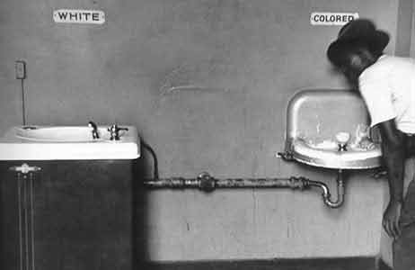
Segregation

Slide 33

Affirmative Action

