Slide 1
Review Game
What’s on the ppt?
Chapters 4 - 7

Slide 2
‘What’s on the ppt?’ Rules
2 Teams are Competing
1 Teammate will have his / her back turned to the ppt
Teammates will have 30 seconds to try to describe what is on the ppt, but YOU CAN’T SAY ANY OF THE WORDS ON THE PPT
If the Teammate can guess what’s on the ppt, your team get’s a point!
Whoever ends with the most points wins!

Slide 3
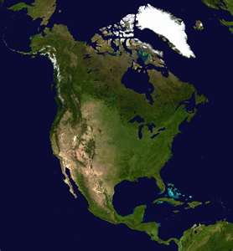
Example
The word is ‘North America’
Teammates can not say ‘North’ or ‘America’
Also, no rhyming or starts with ‘N’

Slide 4
Frederick Douglass

Slide 5
Crispus Attucks

Slide 6
American Revolution

Slide 7
Cotton Kingdom

Slide 8
Declaration of Independence

Slide 9
Cotton Gin

Slide 10
Black Enlightenment

Slide 11
Loyalist

Slide 12
Phillis Wheatley

Slide 13
Jim Crow Laws

Slide 14
Slave Revolt

Slide 15
Patriot

Slide 16
Emancipation

Slide 17
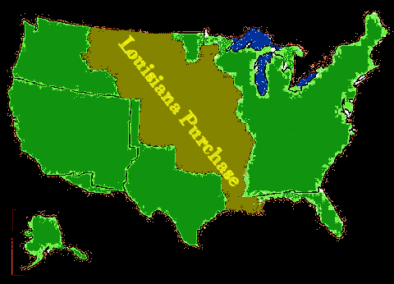
Louisiana Purchase

Slide 18
Black Migration

Slide 19
Skilled Slave

Slide 20
Missouri Compromise

Slide 21
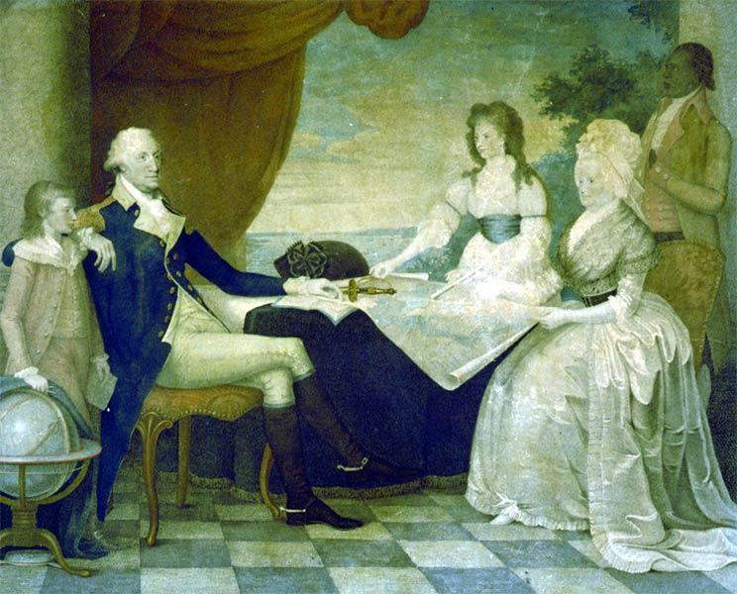
Antebellum America

Slide 22
Free Blacks

Slide 23
Urban North

Slide 24
Industrial Revolution

Slide 25
African-American Church

Slide 26
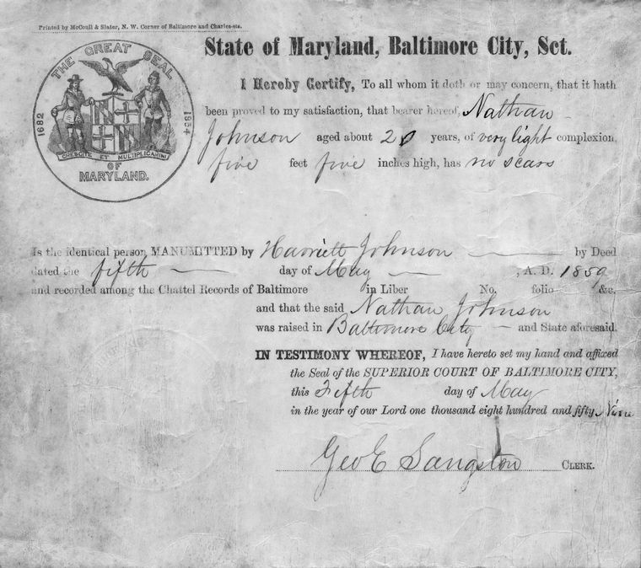
Free Papers

