Slide 1
Ch. 7 Notes
Our Enduring Constitution

Slide 2
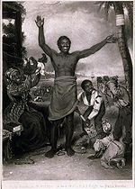
Section 1
Changing the Law of the Land
Amendments reflect efforts to adapt the Constitution to meet changing needs and attitudes. (17 amendments added to Bill of Rights)
Example: 13th Amendment
  Abolition of Slavery in the year 1865

Slide 3

Evolving Voting Rights
Amendment # | Year | Change
15th | 1870 | Voting Rights for African American Men
19th | 1920 | Voting Rights for Women
26th | 1971 | Voting Age Lowered to Eighteen

Slide 4
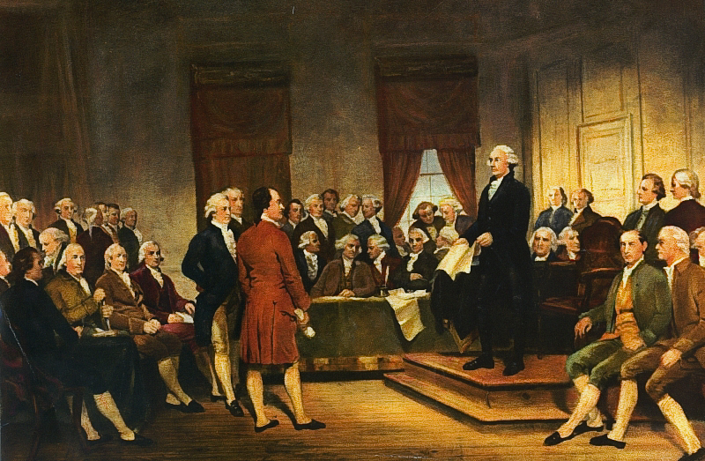
Section 2
A Flexible Framework
The Framers of the Constitution provided general principles, so that future generations would have the freedom to fill in the details.

Slide 5
The Role of the Supreme Court
The Supreme Court has the final say over whether government officials or citizens have correctly followed the constitution.
* Not necessarily permanent though.
  Can be overturned by an amendment or later Supreme Court decision.

Slide 6
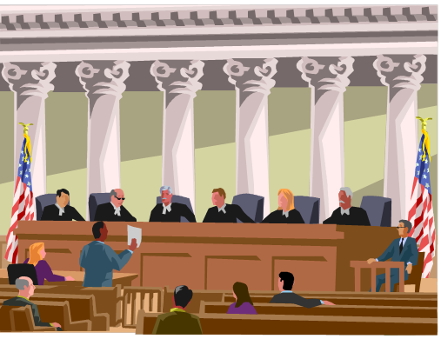
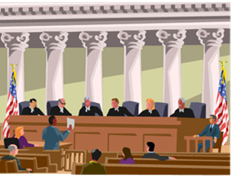
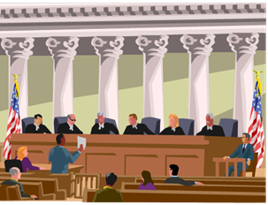
Issues the Supreme has Faced Over the Last Century
Equality and Segregation
  ‘Separate but Equal’ laws ruled unconstitutional.
Equality and Affirmative Action
  Steps taken to counteract effects of past discrimination.
Women and Equality
  Companies can not have ‘one hiring policy for women and another for men.’

Slide 7

Quick Review of Chapter 7
Why are amendments so important to the constitution?
In what ways have voting rights evolved since the constitution was drafted?
Do you think the Framers of the Constitution were wise? Why?
What is the Supreme Court’s role concerning Constitutional Rights?

Slide 8

Ch. 7 Assessment
Page 206
Complete # 1 – 9
  Reviewing Key Terms
    Write out the sentence with correct term underlined.
  Comprehension and Critical Thinking
    Write out the question and your response.
  Activities
    Write out your response.
    * Turn in for a grade once completed.

