Slide 1
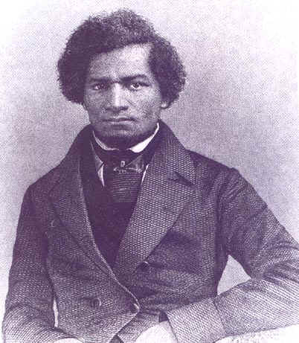
Unit 2: African-Americans in the New Nation (1763-1861)
African-Americans, both free and slave, struggle to find their way in the newly established United States of America.
Frederick Douglass: a former slave who escaped and became a fervent abolitionist in the north.

Slide 2
Quick Review of Ch. 4 - 6
In what ways were African-Americans involved in the American Revolution for Independence?
How did black leaders attempt to strengthen communities for free African-Americans?
Why did slavery cease in the North, but expand in the South during the early 1800s?

Slide 3
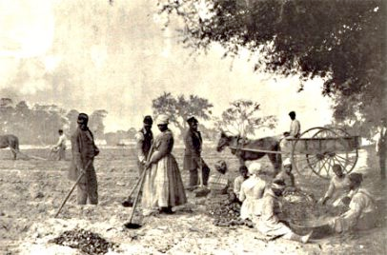
Ch. 7 Free Black People in Antebellum America (1820 – 1861)
Free blacks living in pre-civil war (antebellum) America faced the challenges and limits of their freedom.

Slide 4
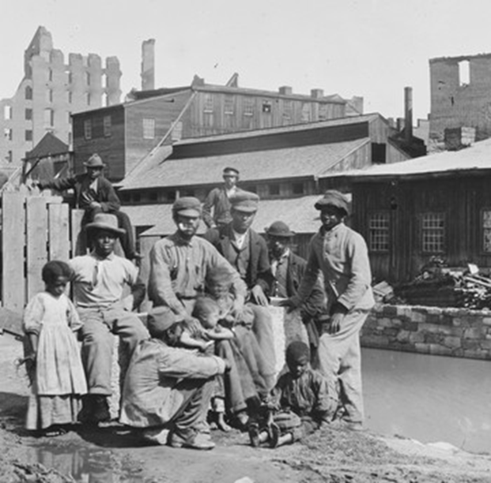
Section 1: Freedom
By 1860…
  the free black population had grown substantially, but was still only 1.6 % of the total population.
  Almost half of the free black population lived in cities of the north and upper south.
    Industrial Revolution = Jobs in the Cities

Slide 5
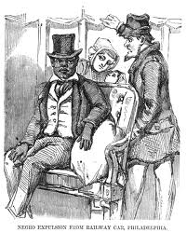
Section 2: Limits of Freedom
Even in the North, whites limited black freedom in important ways.
  Black laws restricted the migration of blacks.
  Laws (such as having to own property to vote) prevented the majority of black men from voting.
  ‘Jim Crow’ Laws enforced the segregation of whites and blacks.
    Ex: African-Americans had to sit in designated train cars.

Slide 6
Quick Discussion
Why do you think many whites during this time wanted to limit the rights and freedoms of free-blacks?

Slide 7
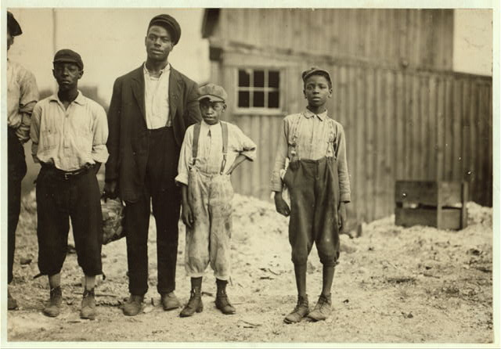
Section 3: Black Communities in the Urban North
Blacks in the North faced challenges…
  Poverty
  Class Divisions
  High Unemployment due to job competition with European immigrants

Slide 8
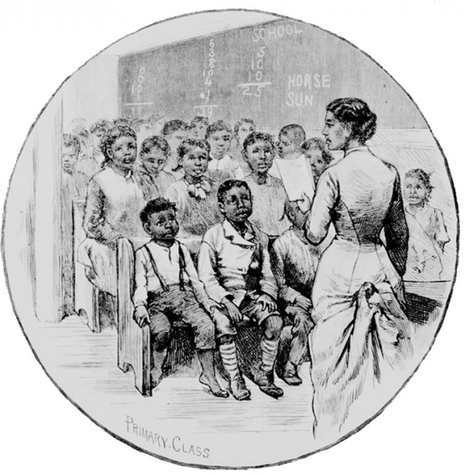
Section 3: Black Communities in the Urban North
Despite the challenges of Urban (city) life, black communities were also characterized by…
  Determined Families
  Active Church Organizations
  The Development of Voluntary Organizations
  Concern for Education
  The Emergence of a Class
  of Northern Black Elite

Slide 9
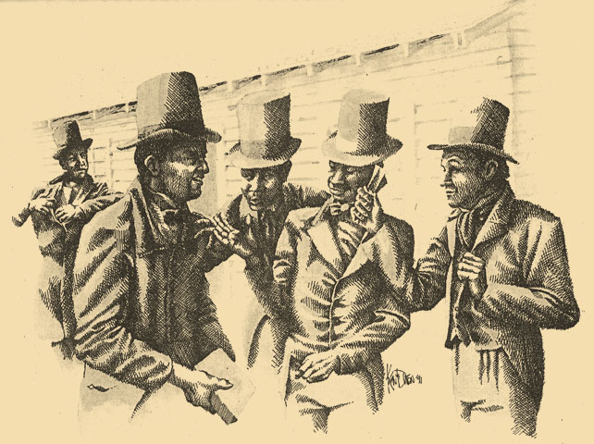
Section 4: African-American Institutions
African-American institutions became stronger, more numerous, and more varied during the first half of the 19th century.
  Schools (Although low funding meant a poor or no education for most black children.)
  Mutual Aid Organizations
  Self-Improvement and Temperance Associations
  Literary Groups
  Newspapers and Journals
  Theaters
  Churches (Remained the most
  important institution, serving as
  community centers.)

Slide 10

Quick Discussion
Why do you think it was important that African-American communities develop these kind of institutions?
  Such as… Literary Groups, Newspapers, Theaters, Churches, etc.

Slide 11
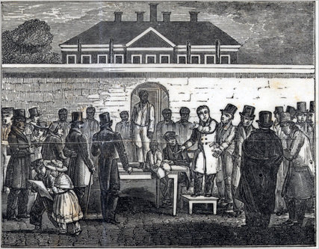
Section 5: Free African Americans
Although free blacks in the upper South (Virginia, Maryland, Delaware and DC) had much in common with free blacks in the North, there were still important differences…
  Those in the upper South lived alongside black slaves.
    Many had family members still trapped in slavery.
  Those in the upper South faced the danger of being re-enslaved.
    If their ‘free papers’ were lost or stolen, they could be sold back into slavery.
    They could be sold into slavery to pay off debt to their creditors.

Slide 12

Quick Review of Ch. 7
Free Black People in Antebellum America
What kind of limitations and challenges did free blacks face during this time?
How would life have been different for a free-black living in the North than a free-black living in the upper South?

